Slide 1
The Microcosm Principle and Concurrency in Coalgebras
Ichiro Hasuo
Kyoto University, Japan
PRESTO Promotion Program, Japan
Bart Jacobs
Radboud Univ. Nijmegen, NL
Technical Univ. Eindhoven, NL
Ana Sokolova
Univ. Salzburg, Austria

Slide 2
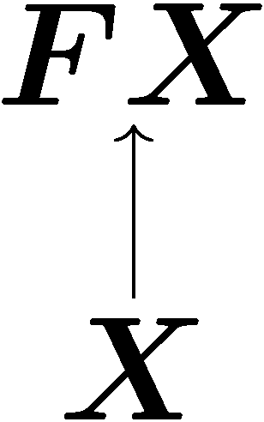
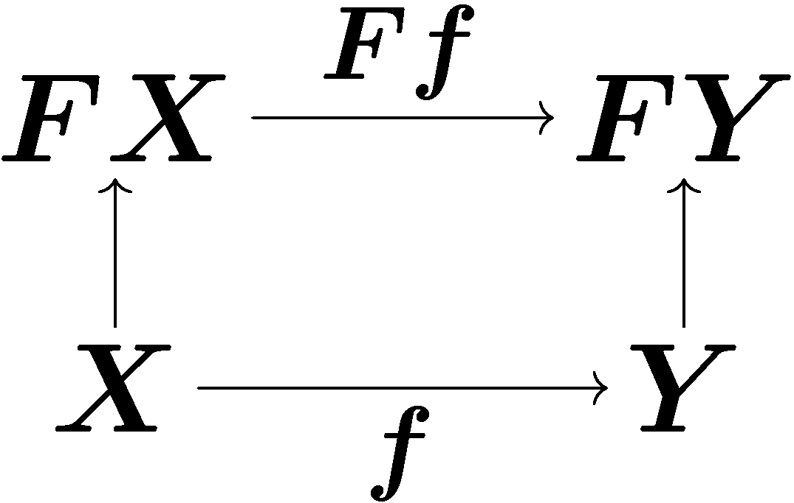
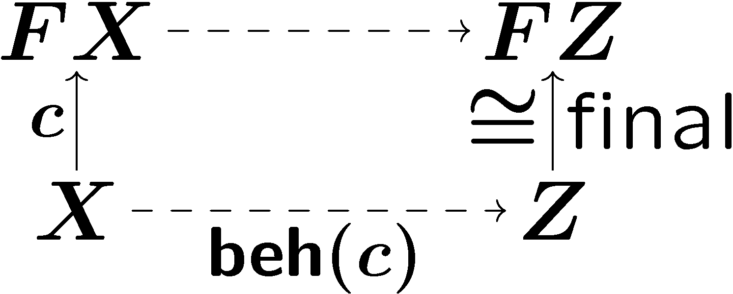
1-slide review of coalgebra/coinduction
Theory of coalgebras
Categorical theory of state-based systems
in Sets : bisimilarity
in Kleisli: trace semantics
[Hasuo,Jacobs,Sokolova LMCS´07]
 | categorically
system | coalgebra
behavior-preserving map | morphism of coalgebras
behavior | coinduction (via final coalgebra)

Slide 3
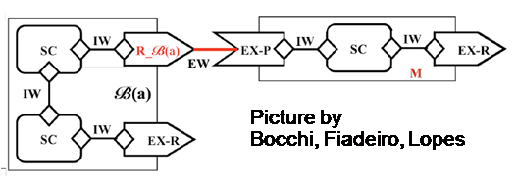
Concurrency
C || D
running C and D in parallel
is everywhere
computer networks
multi-core processors
modular, component-based design of complex systems
is hard to get right
so easy to get into deadlocks
cf. Edward Lee. Making Concurrency Mainstream.
Invited talk at CONCUR 2006.
exponentially growing complexity

Slide 4
Compositionality
aids compositional verification
Behavior of C || D
is determined by
behavior of C and behavior of D
Conventional presentation
~
behavioral equivalence
bisimilarity
trace equivalence
...
„bisimilarity is a congruence“

Slide 5
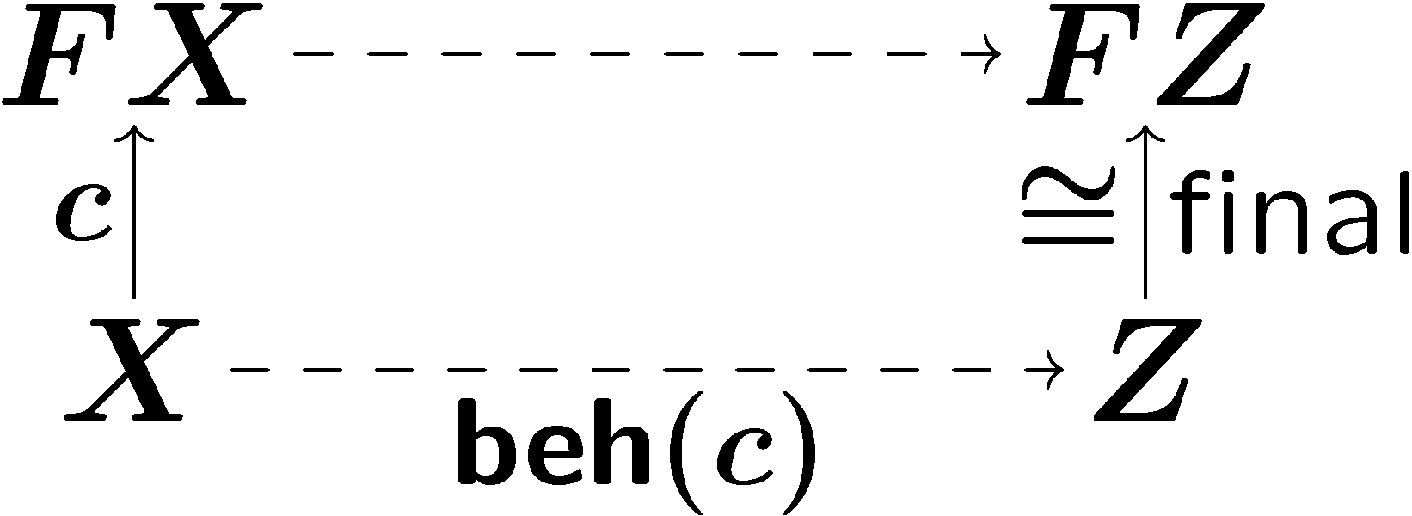
Compositionality in coalgebra
operation on NFAs
|| : Coalg_{F} x Coalg_{F} → Coalg_{F}
composing coalgebras/systems
Final coalgebra semantics as
“process semantics”.
“Coalgebraic compositionality”
On coalgebras
|| : Coalg_{F} x Coalg_{F} → Coalg_{F}
operation on regular languages
|| : Z x Z → Z
composing behavior
On states
|| : Z x Z → Z

Slide 6
the microcosm principle
Nested algebraic structures:
with
inner interpretation
X 2 C
outer interpretation
algebraic theory
operations
binary ||
equations
e.g. assoc. of ||
The same “algebraic theory”
operations (binary ||)
equations (e.g. associativity of ||)
is carried by
the category Coalg_{F} and
its object Z 2 Coalg_{F}
in a nested manner!
“Microcosm principle” (Baez & Dolan)

Slide 7
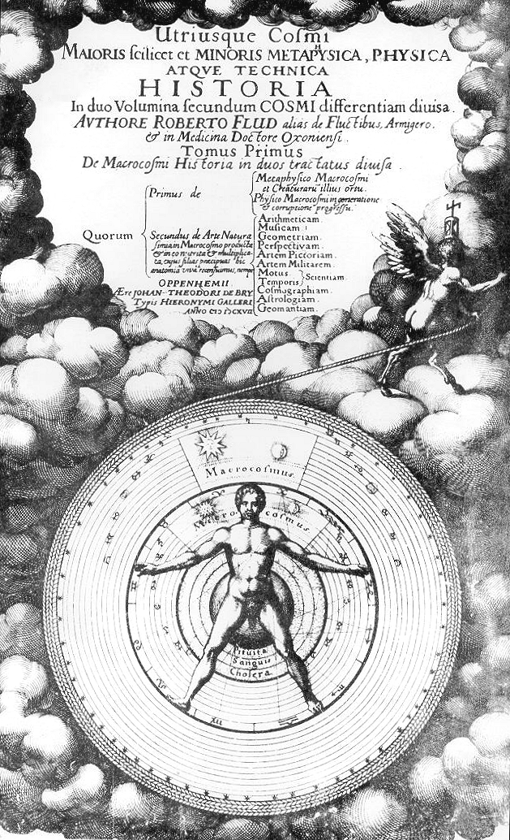
Microcosm in macrocosm
We name this principle the microcosm principle, after the theory, common in pre-modern correlative cosmologies, that every feature of the microcosm (e.g. the human soul) corresponds to some feature of the macrocosm.
John Baez & James Dolan
Higher-Dimensional Algebra III:
n-Categories and the Algebra of Opetopes
Adv. Math. 1998

Slide 8
The microcosm principle: you may have seen it
monoid in a monoidal category
You may have seen it
“a monoid is in a monoidal category”
inner depends on outer

Slide 9
Formalizing the microcosm principle
What do we mean by
“microcosm principle”?
i.e. mathematical definition of such nested models?
Answer
inner model
as lax natural trans.
algebraic theory
as Lawvere theory
outer model
as prod.-pres. functor

Slide 10
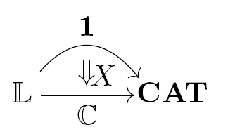
Outline
for arbitrary algebraic theory
concurrency/
compositionality
generic compositionality theorem
microcosm for concurrency
(|| and ||)
parallel composition
via sync nat. trans.
2-categorical formulation
mathematics

Slide 11
Parallel composition of coalgebras
via
sync_{X,Y} : FX ­ FY → F(X ­ Y)
Part 1

Slide 12
Parallel composition of coalgebras
bifunctor Coalg_{F} x Coalg_{F} → Coalg_{F}
usually denoted by ­ (tensor)
Theorem
­ : Coalg_{F} x Coalg_{F} → Coalg_{F}
If
the base category C has a tensor
­ : C x C → C
and F : C → C comes with natural transformation
sync_{X,Y} : FX ­ FY → F(X ­ Y)
then we have
­ : Coalg_{F} x Coalg_{F} → Coalg_{F}
F with sync
lifting
­ : C x C → C

Slide 13
Parallel composition via sync
F
??
(X ­ Y)
sync_{X,Y}
FX ­ FY
c ­ d
X ­ Y
??
­ on base category
different sync
different ­

Slide 14
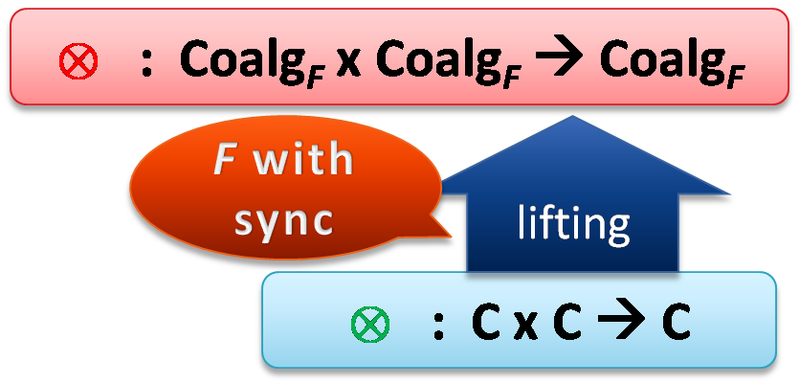
Examples of sync : FX ­ FY → F(X ­ Y)
x : Sets x Sets → Sets
CSP-style (Hoare)
CCS-style (Milner)
Assuming
C = Sets, F = P_{fin}(Σ x _)
F-coalgebra = LTS

Slide 15
Inner composition
|| “composition of states/behavior”
arises by coinduction

Slide 16
Compositionality theorem
C has tensor ­
F has sync_{X,Y} : FX ­ FY → F(X ­ Y)
there is a final coalgebra Z → FZ
Assume
1. ­ by 2. || by
3.
by finality
yields:
by finality
yields

Slide 17
Equational properties
When is
­ : Coalg_{F} x Coalg_{F} → Coalg_{F}
associative?
Answer When
­ : C x C→ C is associative, and
sync is “associative”
commutativity?
arbitrary algebraic theory?

Slide 18
for arbitrary algebraic theory
2-categorical formulation of
the microcosm principle
Part 2

Slide 19
Microcosm principle (Baez & Dolan)
inner model
outer model
examples
monoid in monoidal category
final coalg. in Coalg_{F} with ­
reg. lang. vs. NFAs
What is precisely
“microcosm principle”?
i.e. mathematical definition of such nested models?

Slide 20
Lawvere theory L
a category representing an algebraic theory
Definition
A Lawvere theory L is a small category s.t.
L’s objects are natural numbers
L has finite products

Slide 21
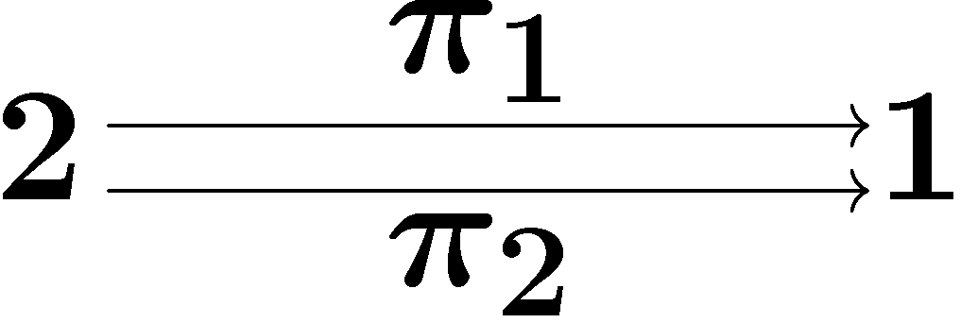
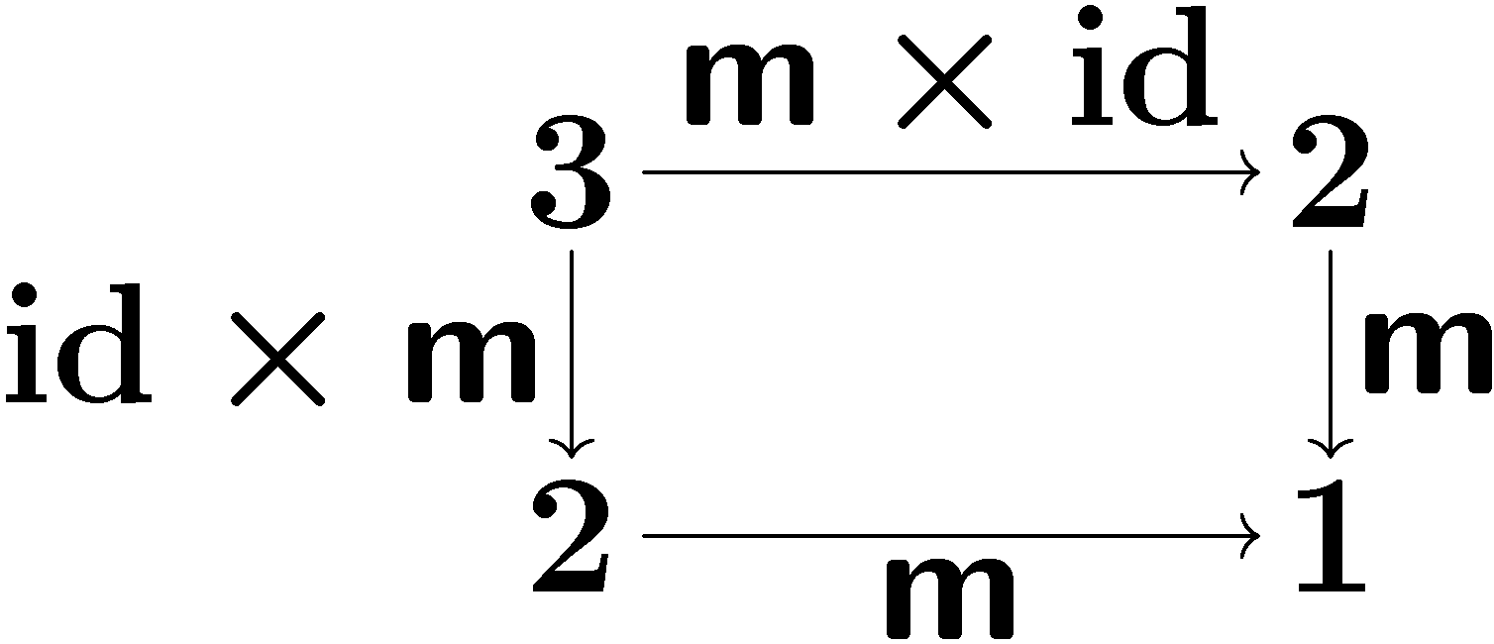
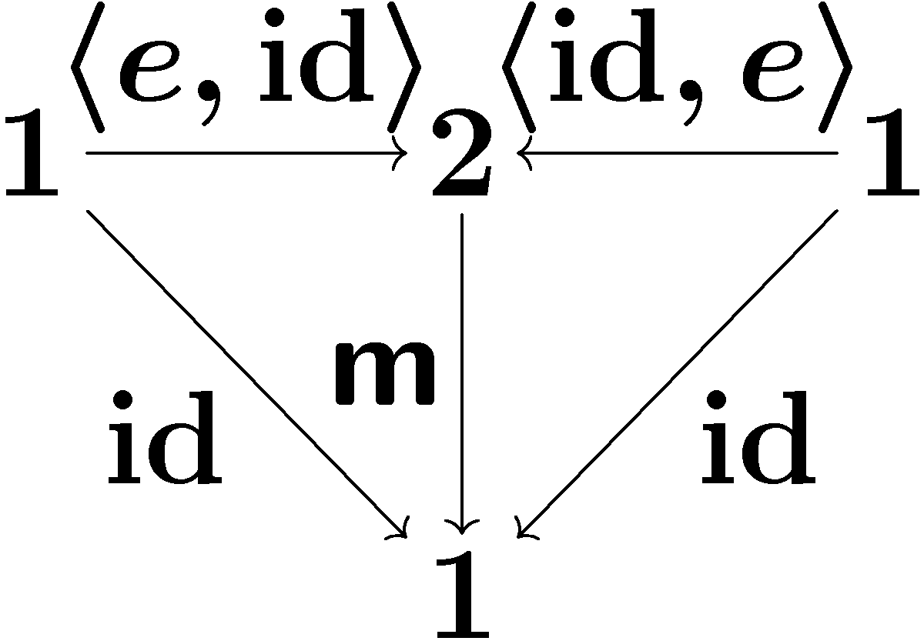
Lawvere theory
other arrows:
projections
composed terms
algebraic theory | as category L
operations | as arrows
equations | as commuting diagrams
m (binary)
e (nullary)
assoc. of m
unit law

Slide 22
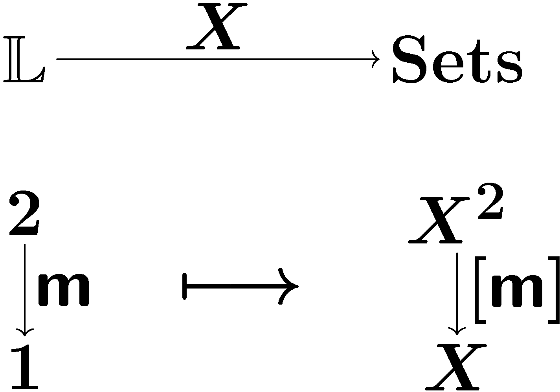
Models for Lawvere theory L
Standard: set-theoretic model
a set with L-structure ➔ L-set
(product-preserving)
binary opr. on X
what about nested models?
X 2 C

Slide 23
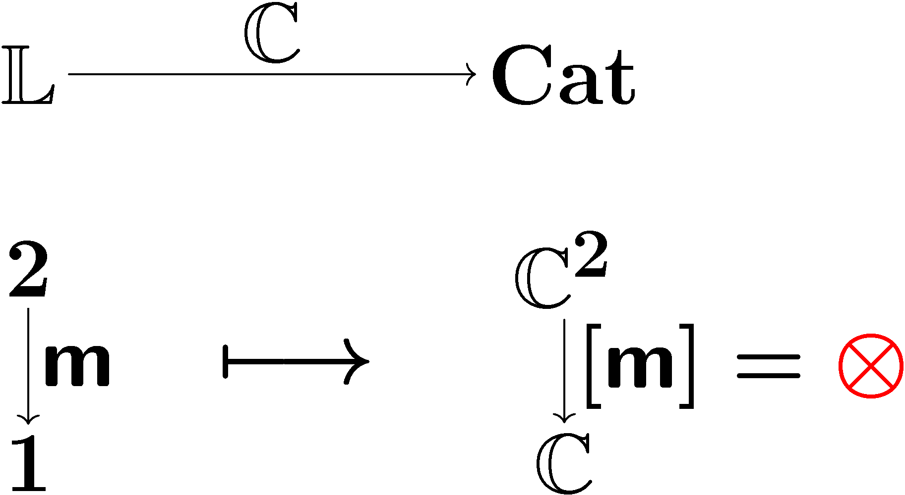
Outer model: L-category
outer model
a category with L-structure ➔ L-category
(product-preserving)
NB. our focus is on strict alg. structures

Slide 24
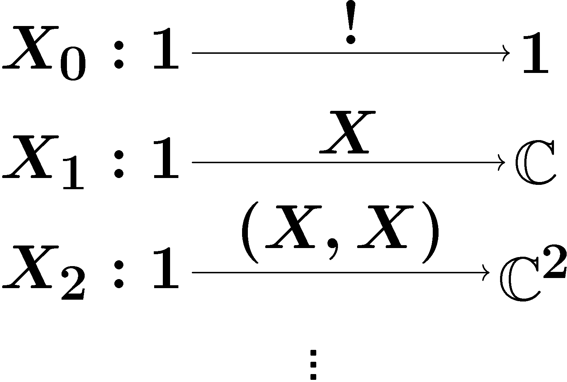
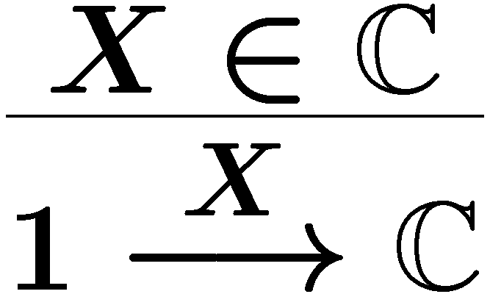
Inner model: L-object
Definition
inner alg. str.
by
mediating 2-cells
Given an L-category C,
an L-object X in it
is a lax natural transformation
compatible with products.
components
lax naturality
X: carrier obj.
Definition
Components

Slide 25
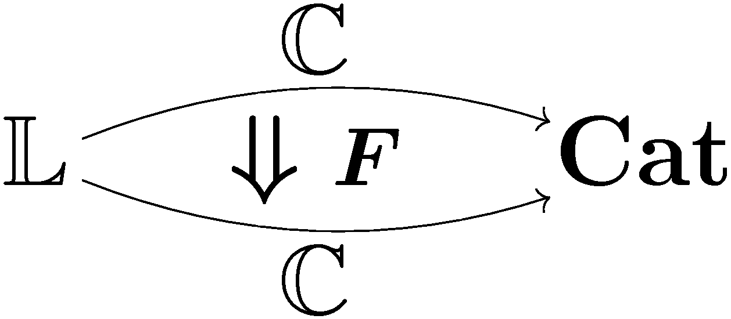
Facts
lax L-functor = F with sync
lax L-functor?
lax natur.
trans.
C: L-category
F: C → C, lax L-functor
➔ Coalg_{F} is an L-category
Generalizes
lax naturality?
C: L-category
Z 2 C , final object
➔ Z is an L-object
Generalizes
...
Notes:
which is DELETE?

Slide 26
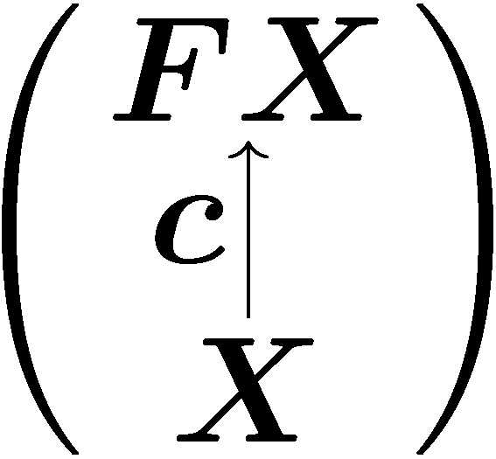
Generic compositionality theorem
C is an L-category
F : C → C is a lax L-functor
there is a final coalgebra Z → FZ
Assume
1. Coalg_{F} is an L-category
2. Z → FZ is an L-object
3. the behavior functor
is a (strict) L-functor
by finality
yields
by coinduction
subsumes

Slide 27
Equational properties
associative
­ : Coalg_{F} x Coalg_{F} → Coalg_{F}
lifting
F with
“associative“
sync
associative
­ : C x C → C

Slide 28
Equational properties, generally
L-structure
on Coalg_{F}
equations are built-in in L
as
how about „assoc“ of sync?
automatic
via “coherence condition“
lifting
F : lax L-functor
=
L-structure
on C

Slide 29
Related work: bialgebras
Related to the study of bialgebraic structures
[Turi-Plotkin, Bartels, Klin, …]
Algebraic structures on coalgebras
In the current work:
Equations, not only operations, are also an integral part
Algebraic structures are nested, higher-dimensional

Slide 30
Future work
“Pseudo” algebraic structures
monoidal category (cf. strictly monoidal category)
equations hold up-to-isomorphism
L → CAT, product-preserving pseudo-functor?
Microcosm principle for full GSOS
bialgebra | microcosm
Σ B ➔ B Σ | current work
Σ (B x id) ➔ B T_{Σ} (for full GSOS) | ??

Slide 31
Conclusion
for arbitrary algebraic theory
concurrency/
compositionality
generic compositionality theorem
microcosm for concurrency
(|| and ||)
parallel composition
via sync nat. trans.
2-categorical formulation
Thanks for your attention!
Ichiro Hasuo (Kyoto, Japan)
http://www.cs.ru.nl/~ichiro
mathematics

Slide 32
Conclusion
Microcosm principle :
same algebraic structure
on a category C and
on an object X 2 C
2-categorical formulation:
Concurrency in coalgebras as a CS example
inner model
algebraic theory
outer model
Thank you for your attention!
Ichiro Hasuo, Kyoto U., Japan
http://www.cs.ru.nl/~ichiro

Slide 33
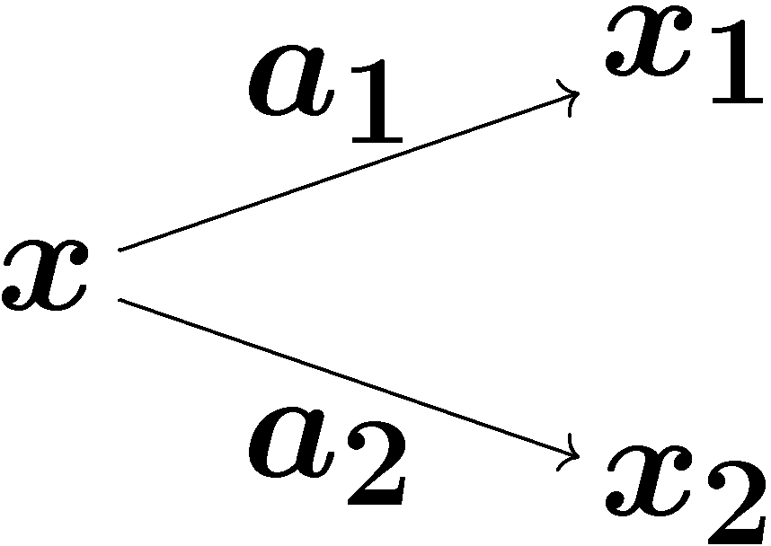
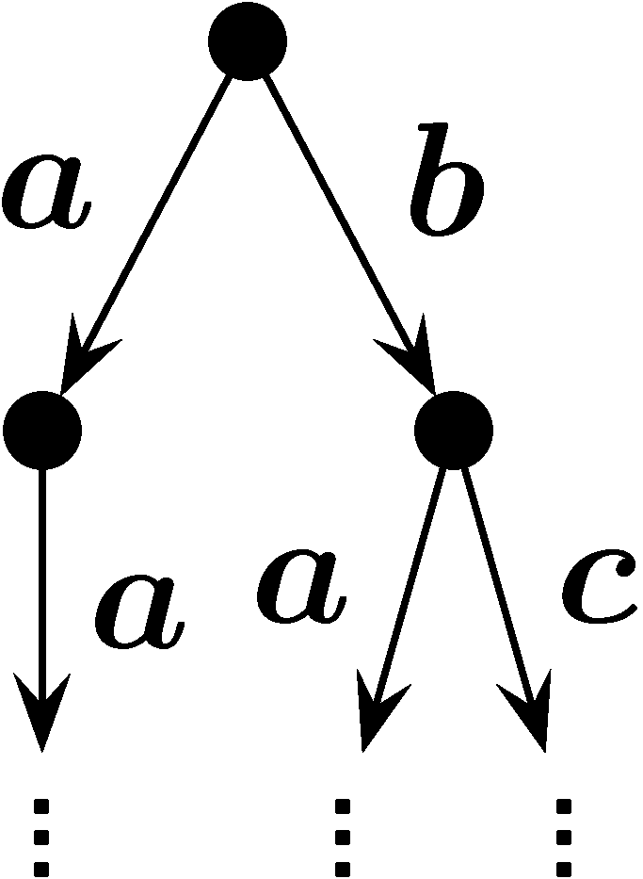
Behavior by coinduction: example
Take F = P_{fin} (Σ £ _) in Sets.
System as coalgebra:
Behavior by coinduction:
in Sets: bisimilarity
in certain Kleisli categories: trace equivalence
[Hasuo,Jacobs,Sokolova,CMCS’06]
the set of
finitely branching
edges labeled with Σ
infinite-depth
trees,
such as
process graph of x
x

Slide 34
Examples of sync : FX ­ FY → F(X ­ Y)
Note:
Asynchronous/interleaving compositions don’t fit in this framework
such as
We have to use, instead of F,
the cofree comonad on F

Slide 35
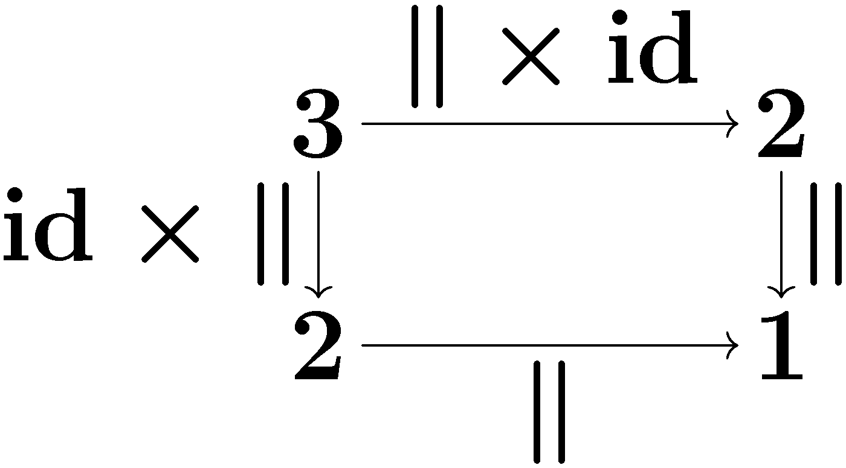
Lawvere theory
Presentation of an algebraic theory as a category:
objects: 0, 1, 2, 3, … “arities”
arrows: “terms (in a context)”
commuting diagrams are understood as “equations”
~ unit law ~ assoc. law
arises from
(single-sorted) algebraic specification (Σ, E) as the syntactic category
FP-sketch
projections
operation
composed term

Slide 36
Outline
In a coalgebraic study of concurrency,
Nested algebraic structures
on a category C and
on an object X 2 C
arise naturally (microcosm principle)
Our contributions:
Syntactic formalization of microcosm principle
2-categorical formalization with Lawvere theories
Application to coalgebras:
generic compositionality theorem

Slide 37
Generic soundness result
A Lawvere theory L is for
operations, and
equations (e.g. associativity, commutativity)
Coalg_{F} is an L-category
➔ Parallel composition ­ is automatically associative (for example)
Ultimately, this is due to the coherence condition on the lax L-functor F
Possible application :
Study of syntactic formats that ensure associativity/commutativity (future work)

Slide 38
Microcosm principle for concurrency (|| and ||)
“Parallel composition via sync nat. trans”
The microcosm principle 2-categorically
Back to concurrency
Part 1 for arbitrary algebraic theory
Generic compositionality theorem
compositionality theorem
nice cake

