Slide 1
Coalgebras in a Kleisli category generic theory of traces and simulations
Ichiro Hasuo
RIMS, Kyoto Univ.
PRESTO “Sakigake” Program, JST
TexPoint fonts used in EMF.
Read the TexPoint manual before you delete this box.: AAAAA

Slide 2
Scope of the workshop
Given a problem,
what solution can I derive from mathematical theories?
synergy
theory
practice
Given a theory,
what is its killer application?

Slide 3
The role of applications: one theoretician’s point of view
Unifying picture/
understanding of the essence
applications as driving force of development of theory
one way to ensure healthy development of theory
…
Further application
Extended theory
application
theory

Slide 4
Welcome
Thanks again for coming all over!!

Slide 5
What this talk is about
Theory of coalgebras as
mathematical theory of state-based systems
system as coalgebra behavior by coinduction
... in which category?
  Sets standard, “behavior” = bisimilarity
  Stone spaces better compatible with modal logic
    [Kupke, Kurz, Venema]
  nominal sets/presheaves models for name-passing calculi
  [Fiore, Staton]
  a Kleisli category suited for traces and simulations

Slide 6
The theory we develop
genericity : both for
T = P (non-determinism)
T = D (probability)
 | in Sets | in Kl(T)
coalgebra | system | system
morphism of coalgebra | functional bisimulation | forward simulation (lax) backward similation (oplax)
by final coalgebra | bisimilarity | trace semantics
theory of bisimilarity
theory of traces and simulations

Slide 7
Genericity of the theory
Coalgebras in the Kleisli category Kl(T)
  T: a parameter, for type of branching
    T = P ➔ non-deterministic branching
    T = D ➔ probabilistic branching
“What we can do in a non-det. setting, we can also do in a probabilistic branching”
  Just change fromT = P to T = D
Exploited in verifying probabilistic anonymity

Slide 8
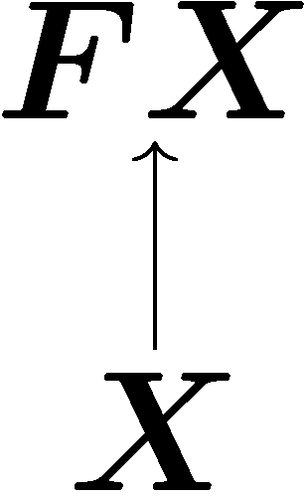
Coalgebra
Definition Let
  C : a category
  F : C → C a functor
A coalgebra is a morphism
in C

Slide 9
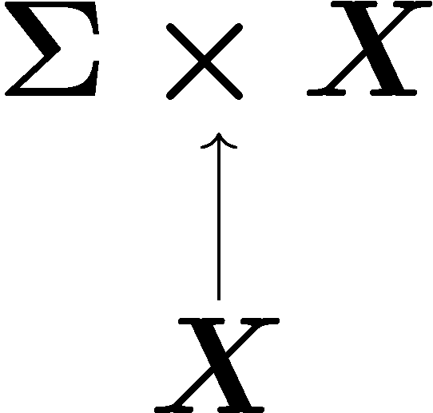
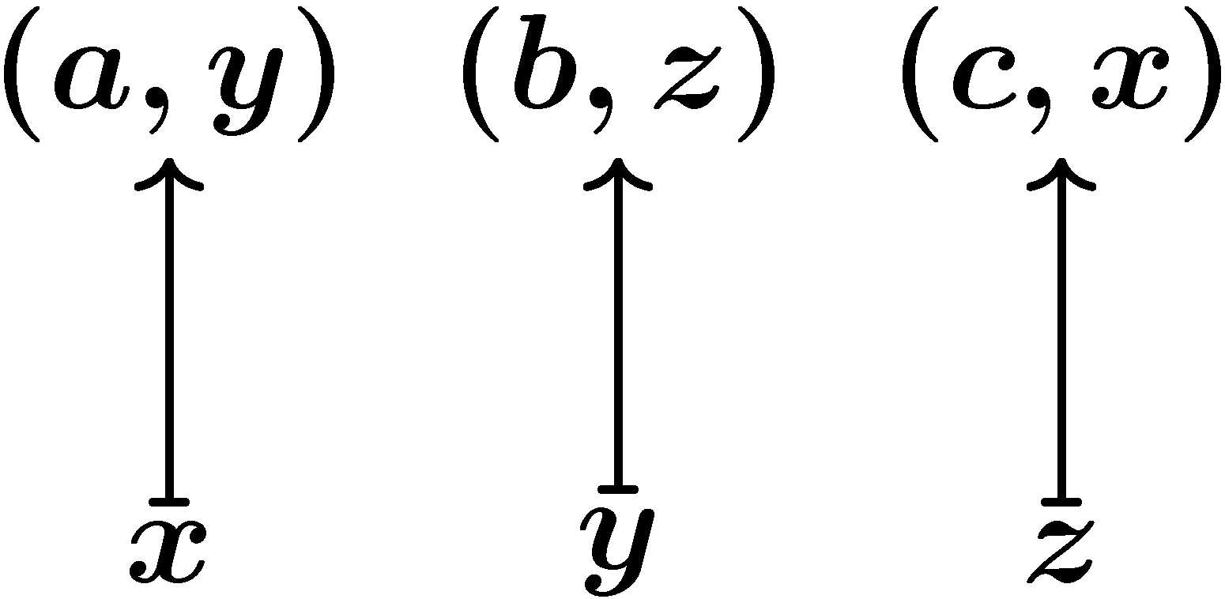
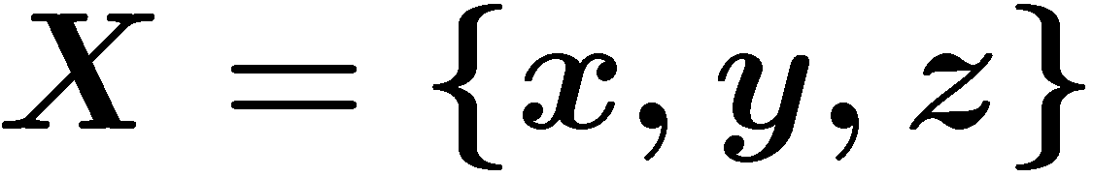

System as coalgebra
a
x
y
b
as
in C
c
z
type of transition
dynamics
state space
C = Sets
F = Σ x _
“action and continue”

Slide 10
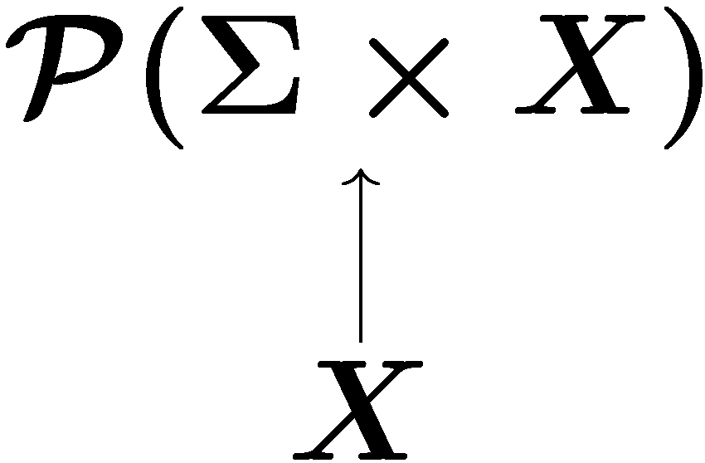
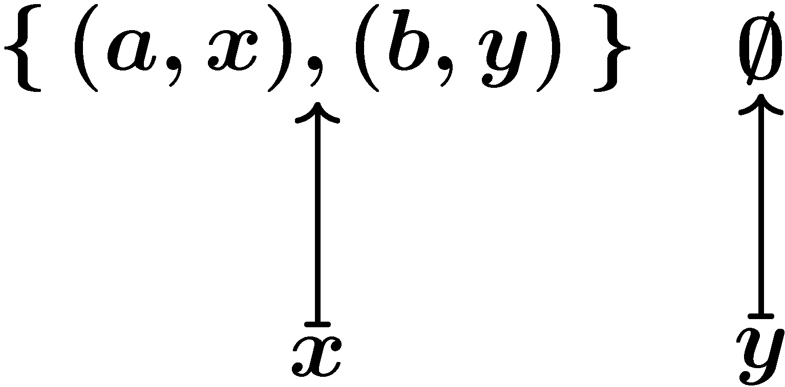
Transition-type: non-determinism
a
as
in C
x
y
b
C = Sets
F = P(Σ x _)
“non-det. choice over
(output and continue)”

Slide 11
Theory of coalgebras
 | coalgebraically
system | coalgebra
behavior-preserving map | morphism of coalgebras
behavior | by final coalgebra “coinduction”

Slide 12
Finality
A categorical principle…
Definition An object Z in C is final
iff
for any object X in C, there is a unique arrow

Slide 13
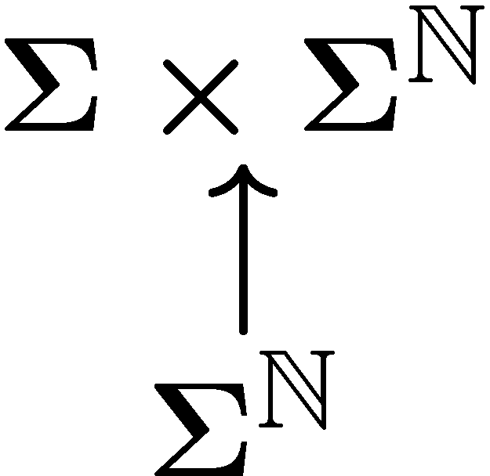
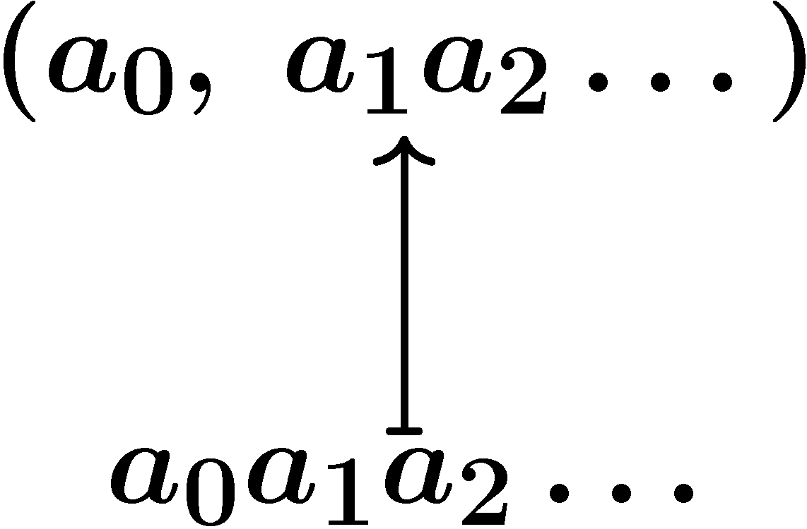
Coinduction: behavior by final coalgebra
a
x
y
C = Sets
F = Σ x _
“output and continue”
as
in C
b
c
z
final F-coalgebra:

Slide 14
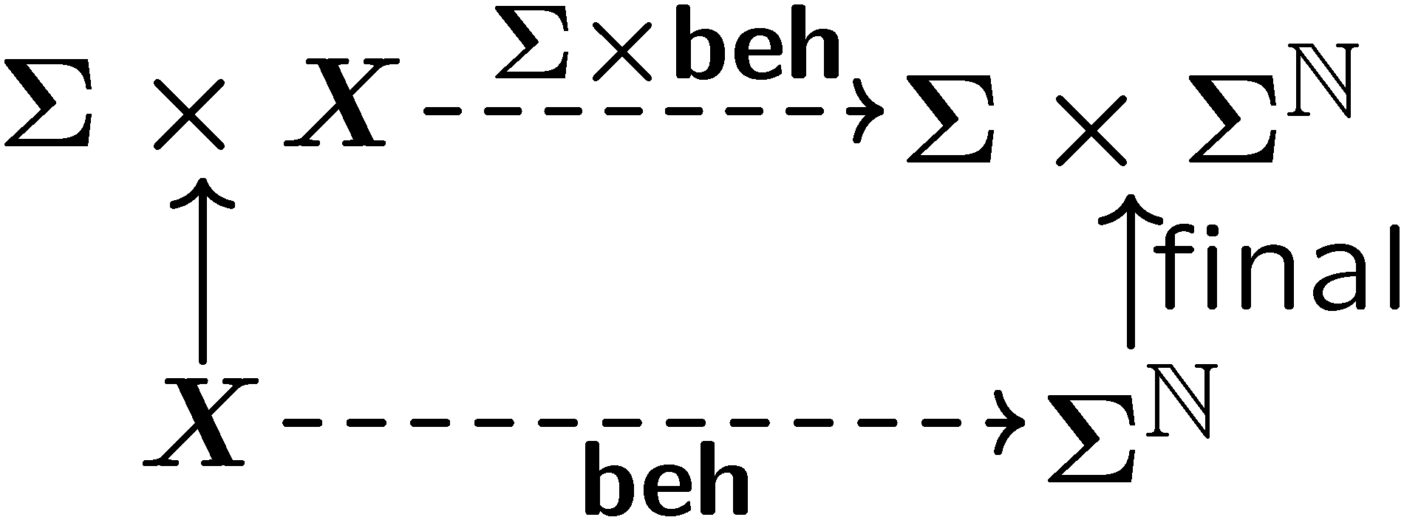
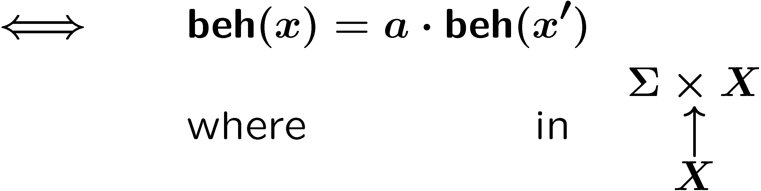
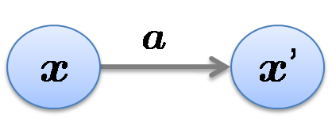
Coinduction: behavior by final coalgebra
(a, x’)
(a, beh(x’))
x
beh(x)
commutativity of the diagram

Slide 15
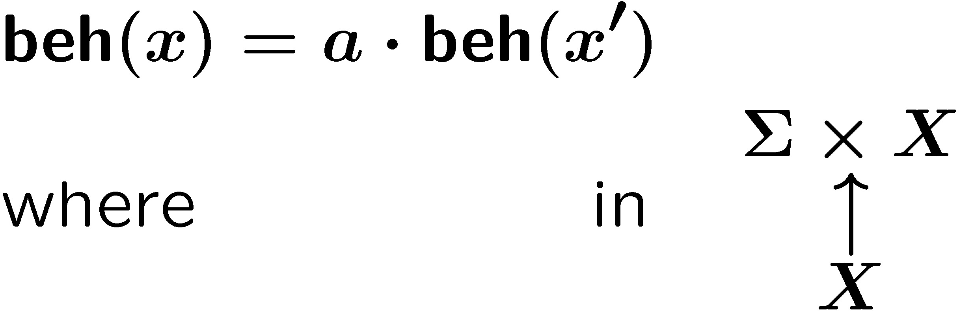
Coinduction: behavior by final coalgebra
conventional def. of behavior
works for a variety of transition-types
i.e. various “signature” functor F
categorical def.

Slide 16
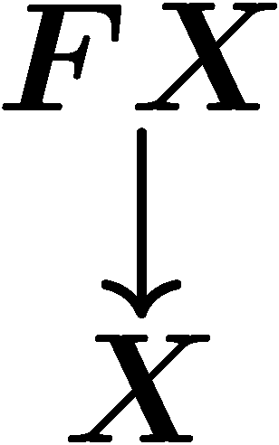
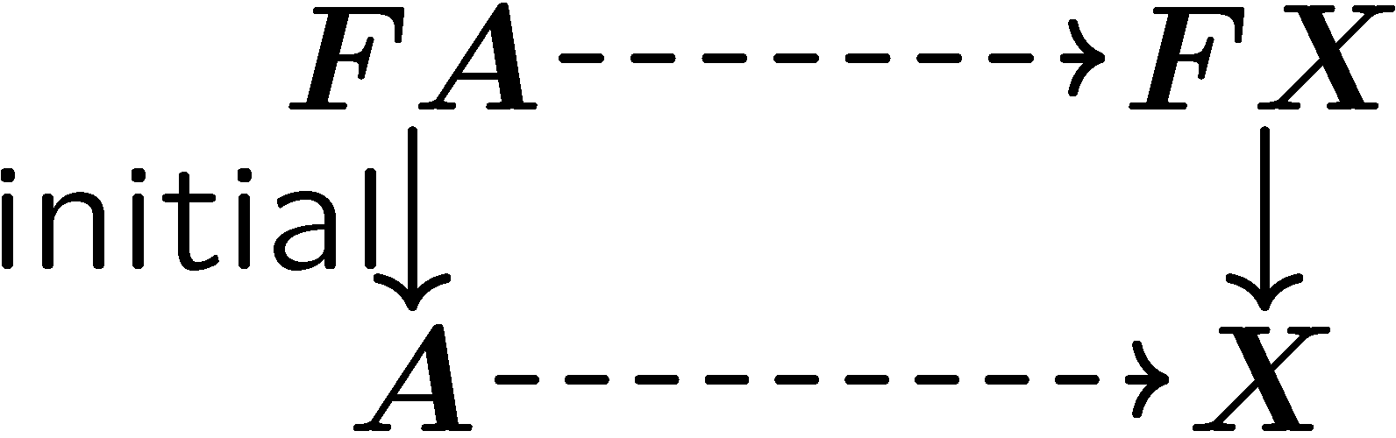
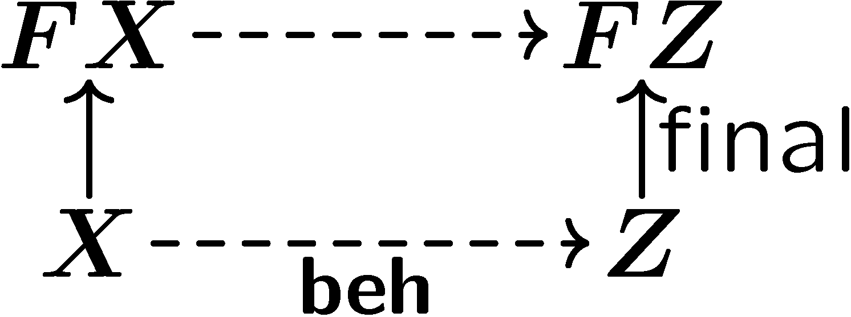
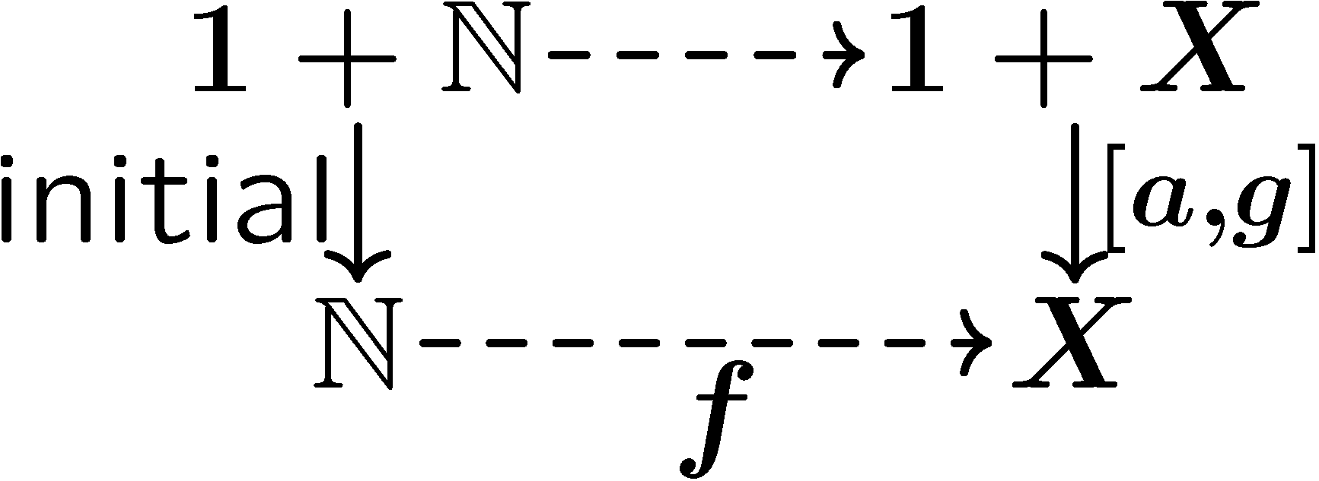
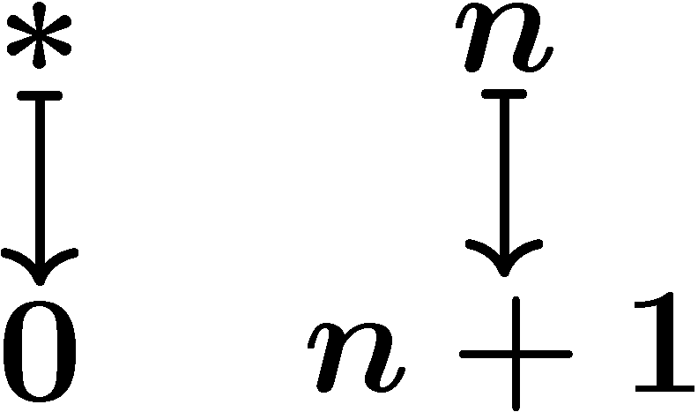
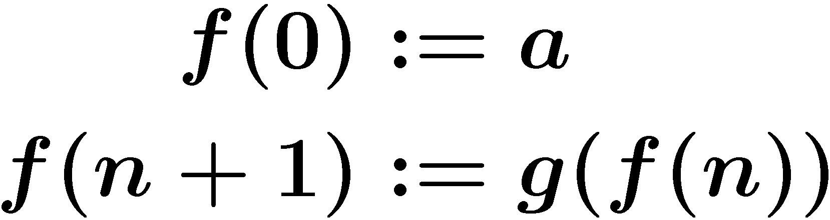
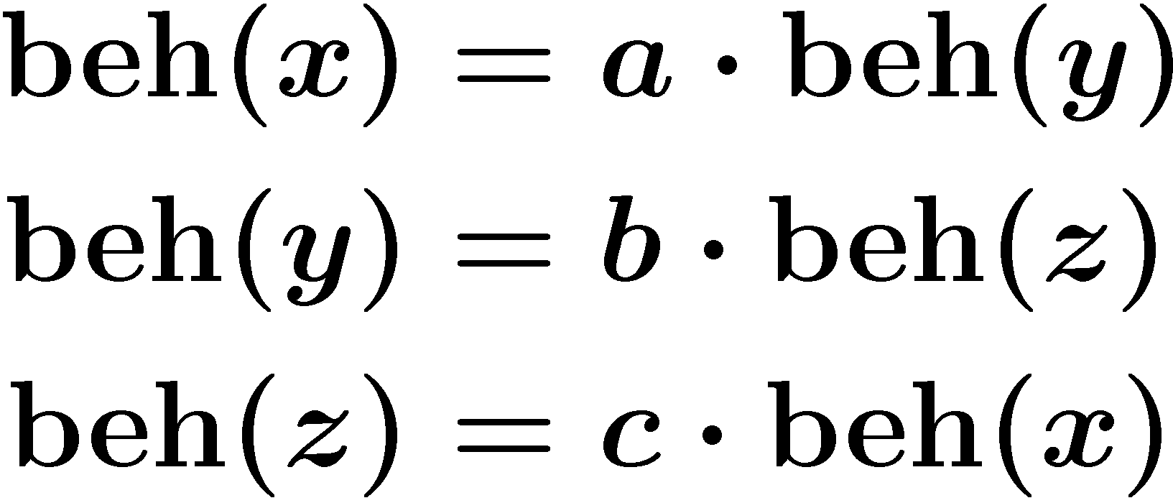
Why “coinduction”?
Ans. Categorical dual of “induction”
algebra | coalgebra
induction by initial alg. | coinduction by final coalg.
e.g. | e.g.
well-founded
non-well-founded

Slide 17
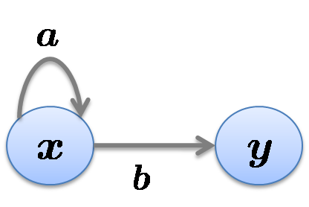
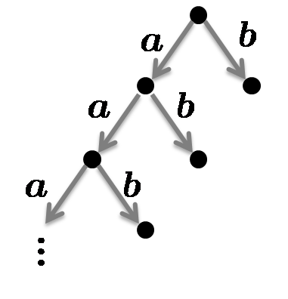
Bisimilarity by coinduction
C = Sets
F = P_{fin}(A £ _)
F-coalgebras are (finitely-branching) LTSs
x
modulo
bisim.
Theorem
beh(x) = beh(y) iff x and y are bisimilar.

Slide 18

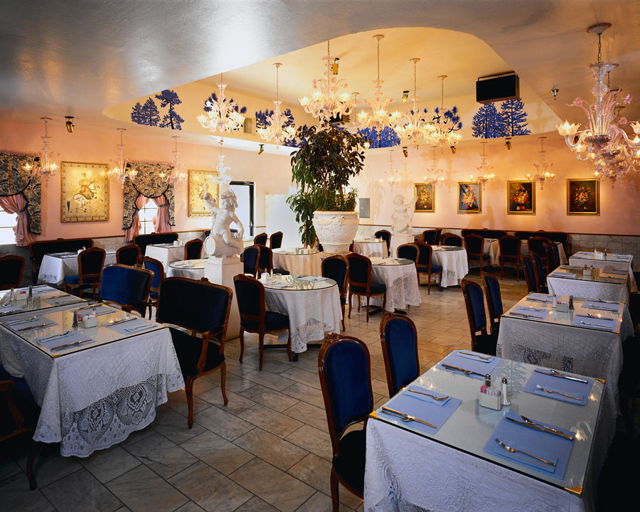


Bisimilarity vs. trace semantics
a
a
≠
a
Also captured by final coalgebra?
b
c
=
b
c
Bisimilarity
When do we decide
or ?
Trace semantics
Anyway we get
→ or
→
Notes:
For some applications, you really need to think of trace semantics!

Slide 19
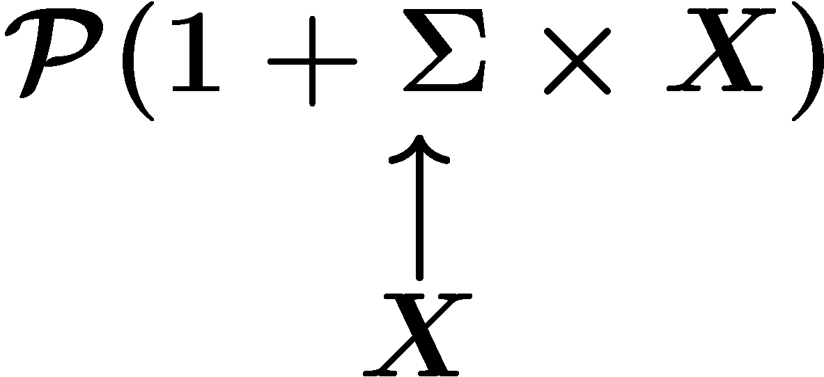
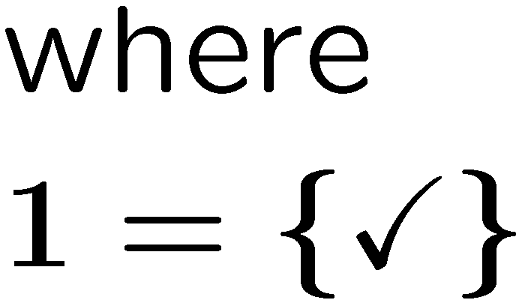

Leading example: trace semantics for LTS with ✓
Definition LTS with ✓ is a coalgebra
  LTS with explicit termination

Slide 20
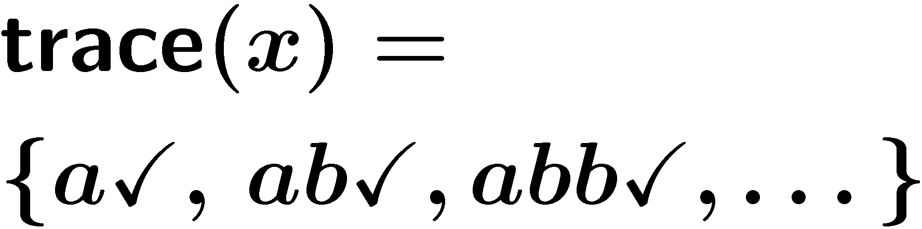
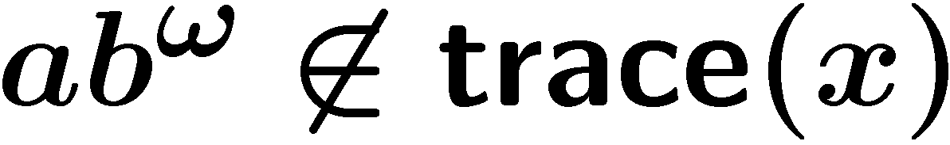

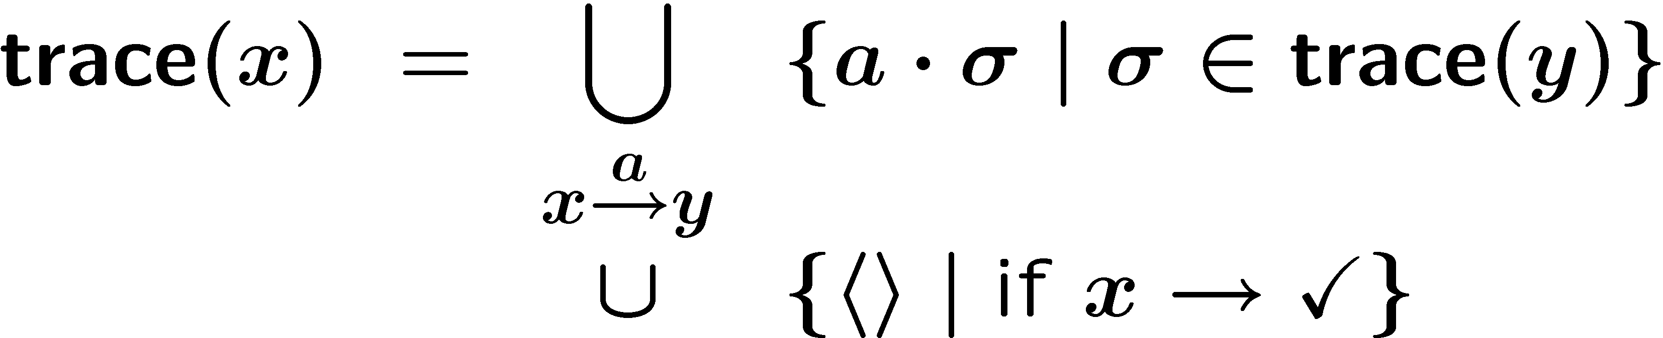
Trace semantics for LTS with ✓
Complete trace semantics, to be precise
Recursive definition:
a
x
y
b
✓

Slide 21
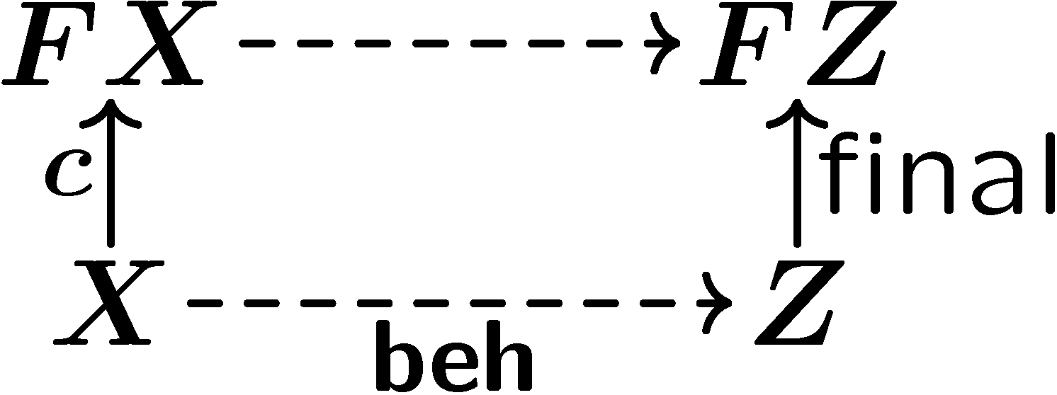

Trace semantics via coinduction in Kl(T)
F: parameter 1
“transition-type”
Observation
beh(x) gives “trace semantics” for x
i.e.
beh(x) = beh(y) iff x and y are trace-equivalent
cf. in Sets:
beh(x) = beh(y) iff x and y are bisimilar
T: parameter 2
“branching-type”

Slide 22

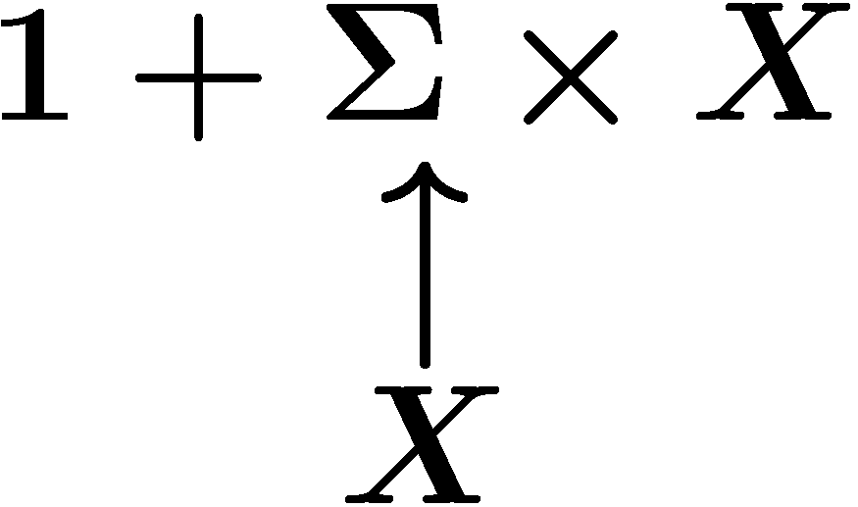

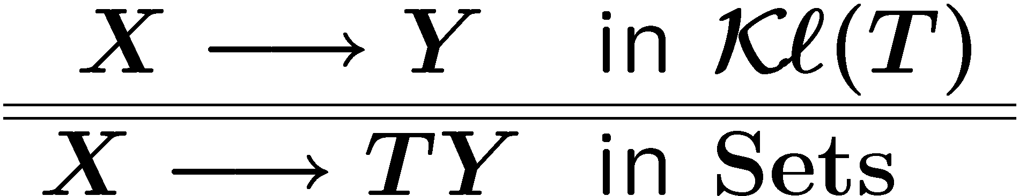
Two parameters: separating transition-type and branching-type
LTS with ✓ as a coalgebra
a category where
branching is implicit
internal branching is unfolded away

Slide 23
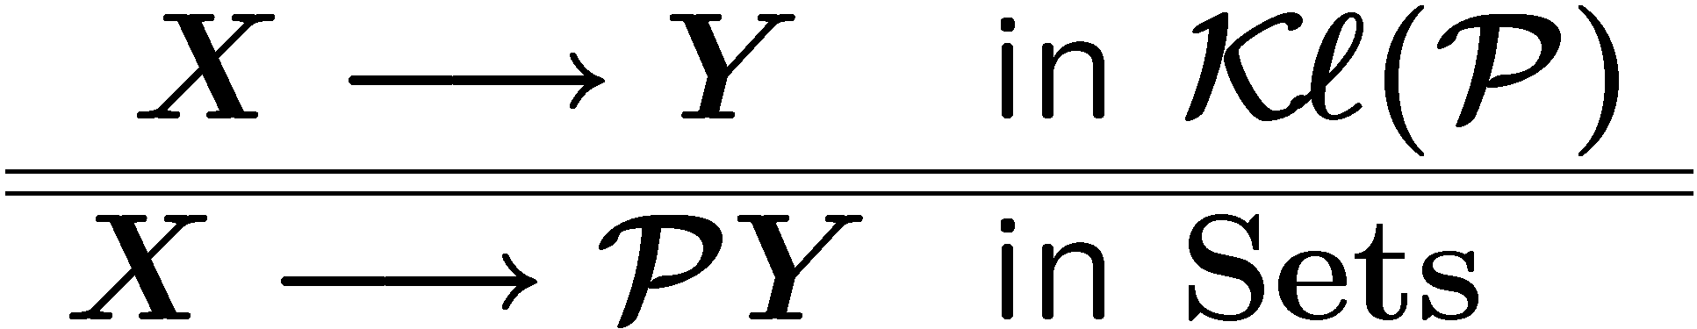
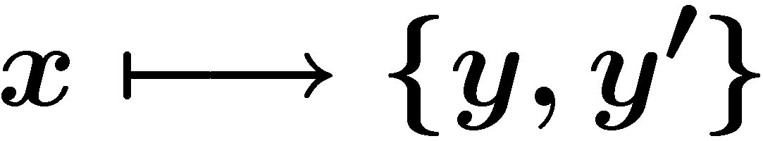
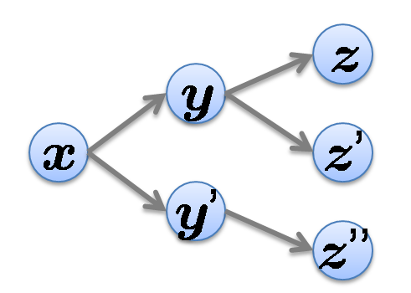
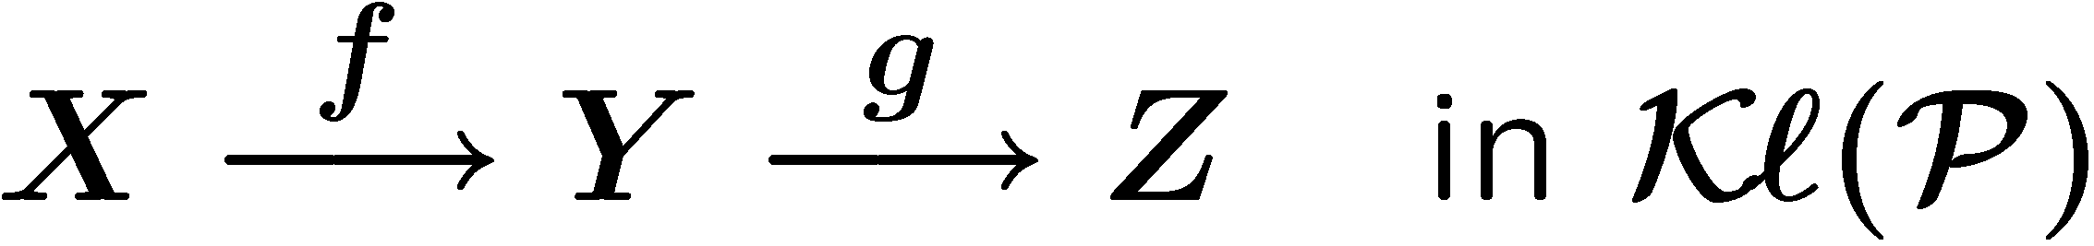
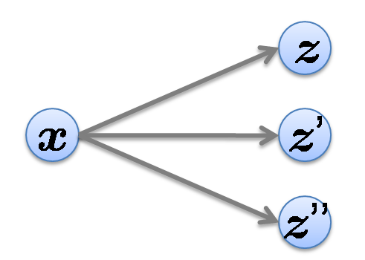
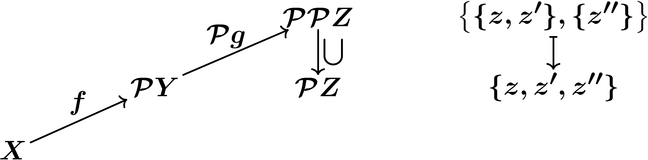
Kleisli category Kl(P)
non-deterministic branching is implicit
Objects same as Sets
Arrows
Composition
z
y
inner branching str. is unfolded away
x
z’
y’
z’’

z
x
z’
z’’

Slide 24
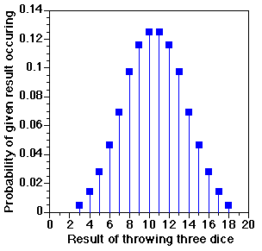
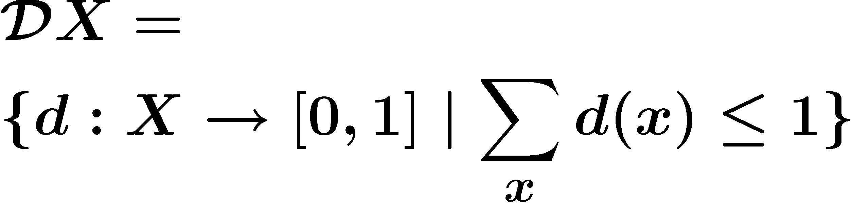
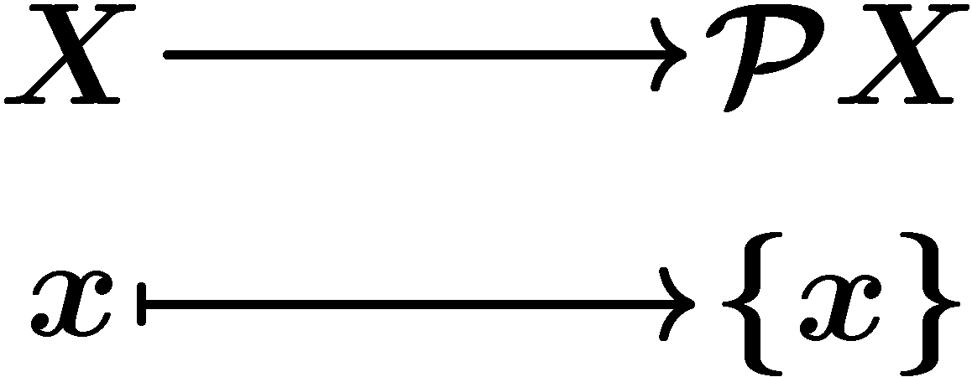
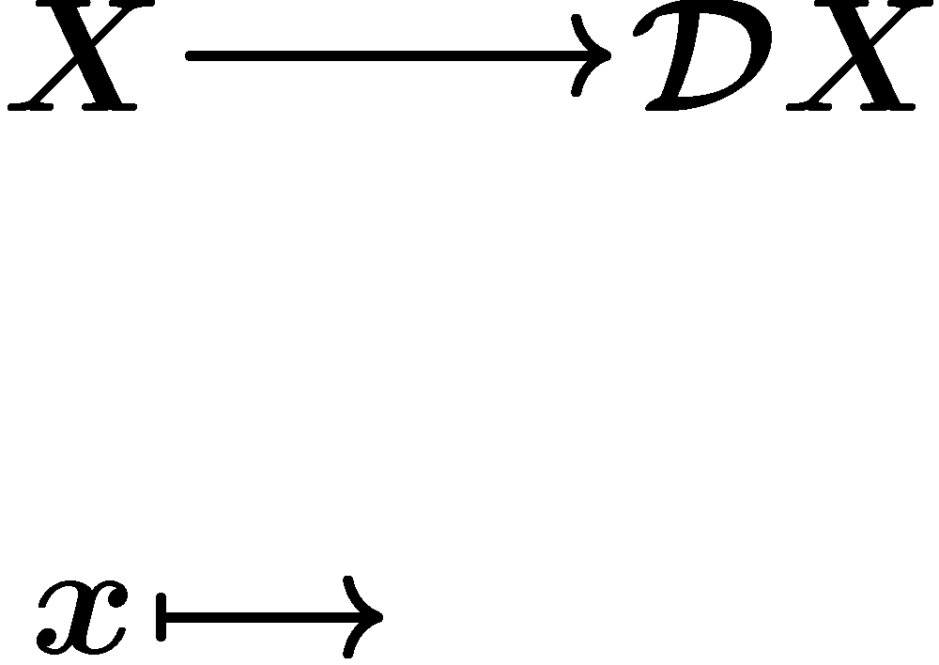
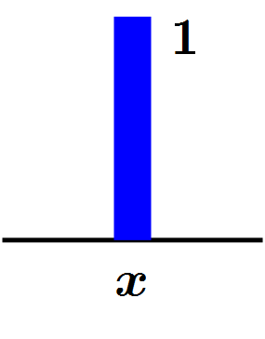
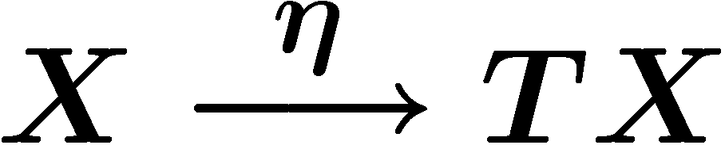
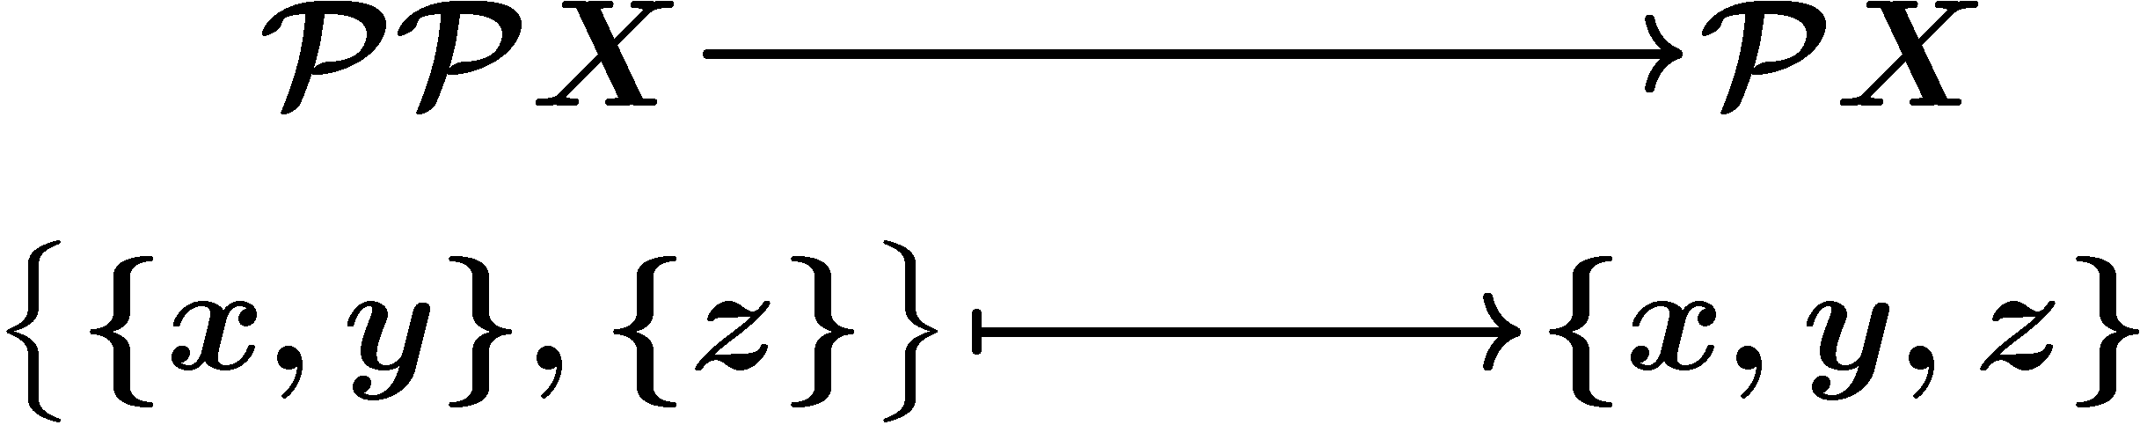
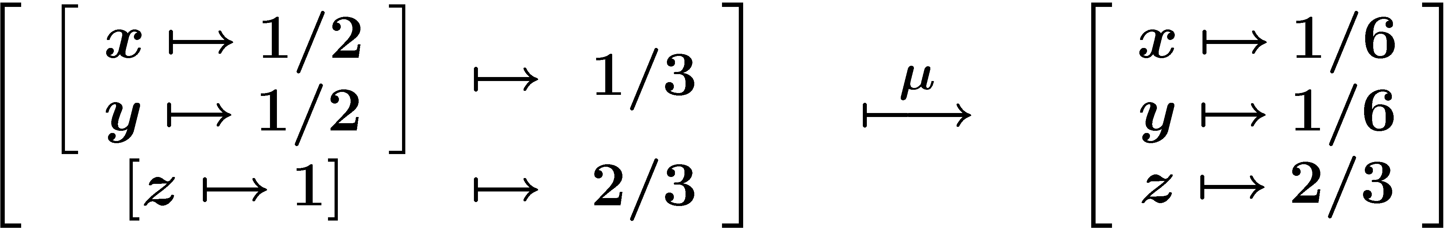
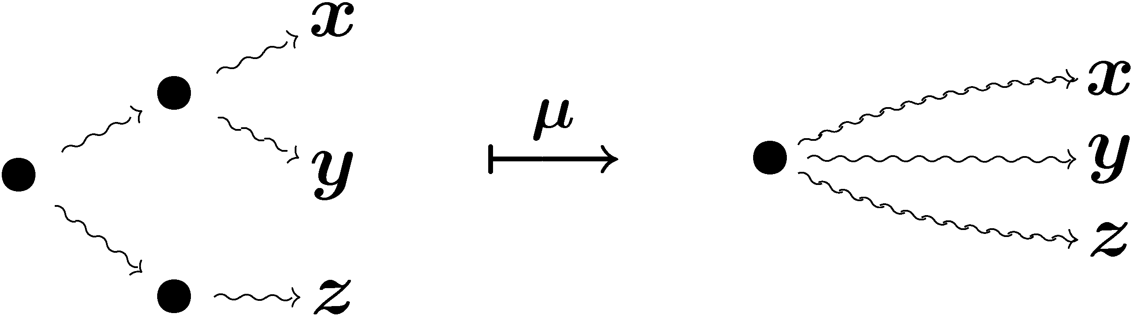
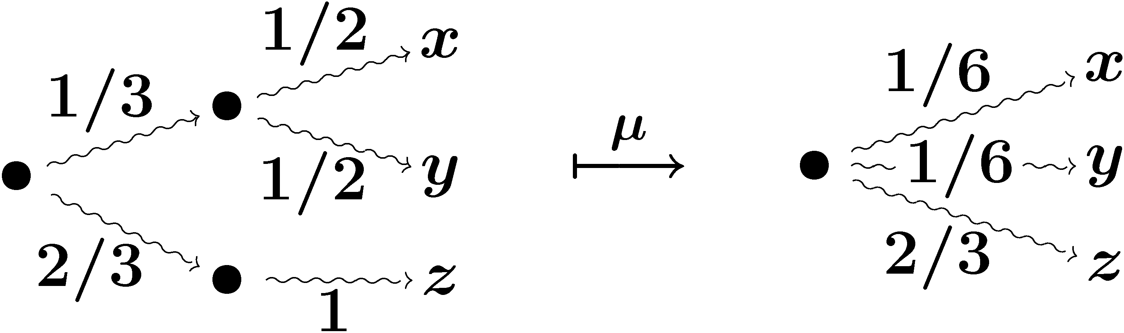

Monad for branching
a monad is a functor T equipped with | P powerset monad | D subdistribution monad | intuition
“unit” | singleton | “Dirac distr.” | trivial branching (with one choice)
“multiplication” | union |  | throwing internal branching away by flattening
Trivial branching
(with only one choice)
Forgetting internal branching
(by flattening)

Slide 25
Trace semantics via coinduction
What is the final coalgebra in a Kleisli category?
in Kl(T)
Kleisli category
branching is implicit
internal branching is unfolded
Commutativity of the diagram
amounts to
the (conventional) definition of trace semantics
such as

Slide 26
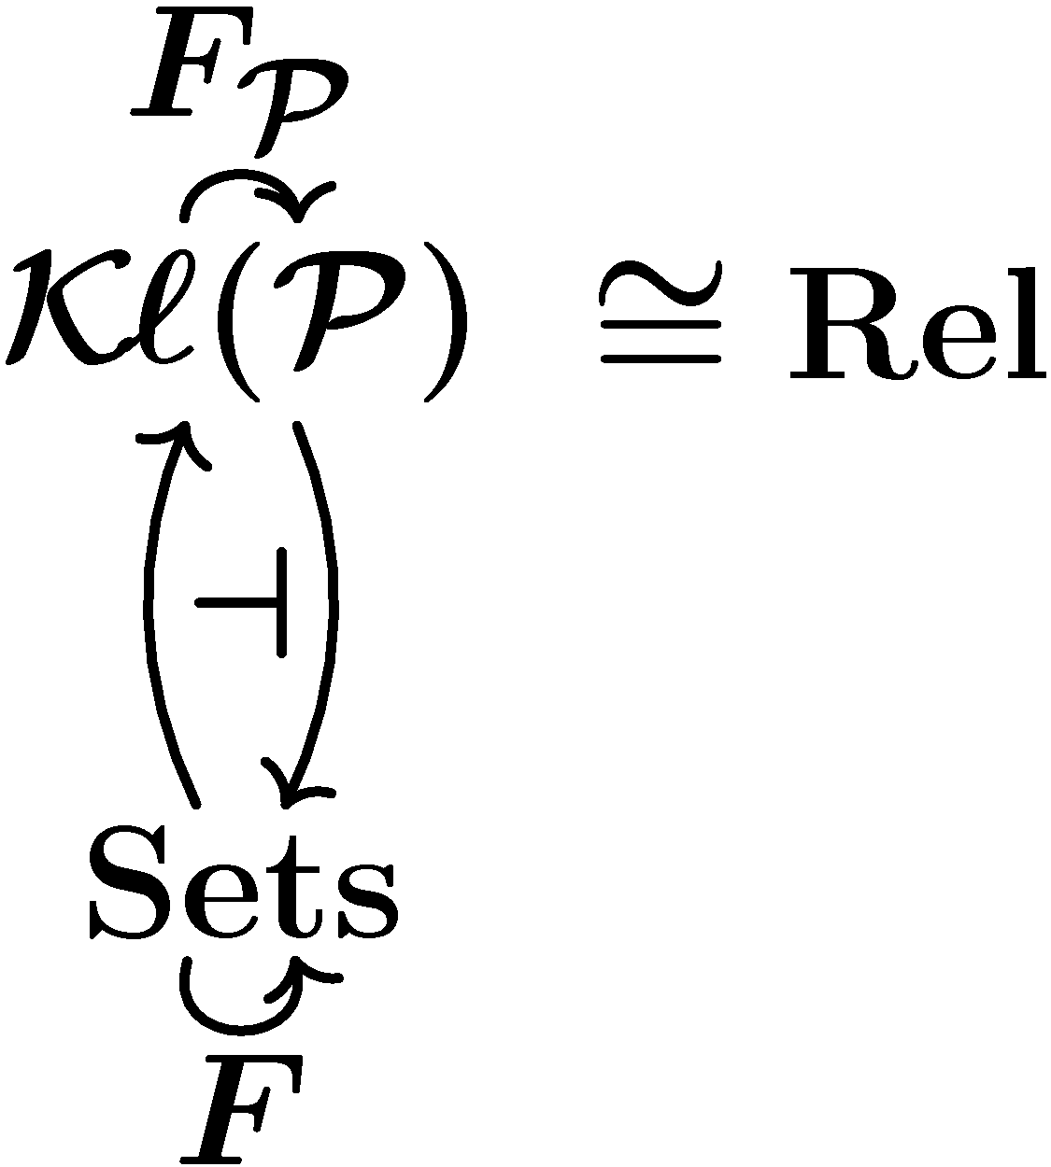
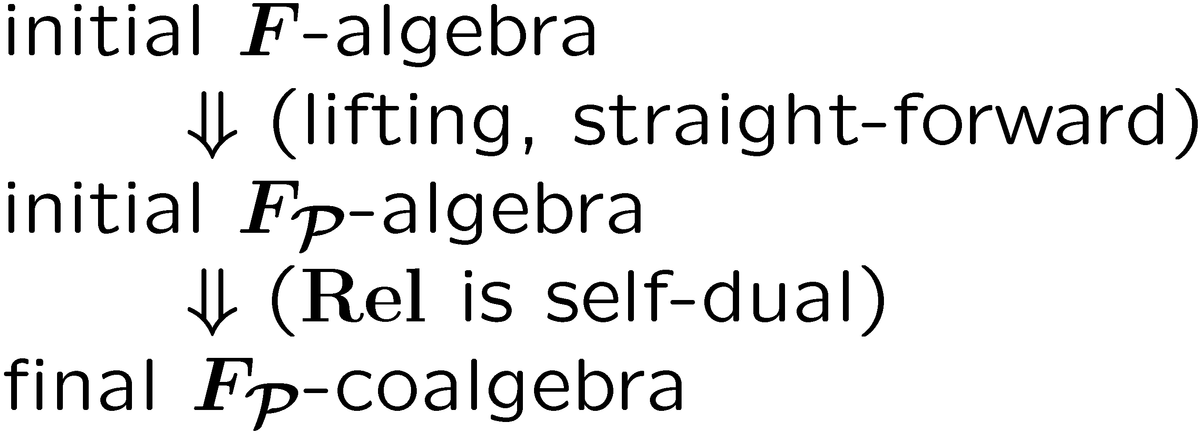
Final coalgebra in a Kleisli category
Theorem
A final coalgebra in Kl(P) is given by an initial algebra in Sets.
Proof.
for a polynomial/shapely functor F,
9 distr. law FP => PF,
which lifts F to F_{P} : Kl(P) -> Kl(P)
Generic Trace Semantics via Coinduction
IH, Bart Jacobs & Ana Sokolova
Logical Method in Comp. Sci.
3(4:11), 2007

Slide 27
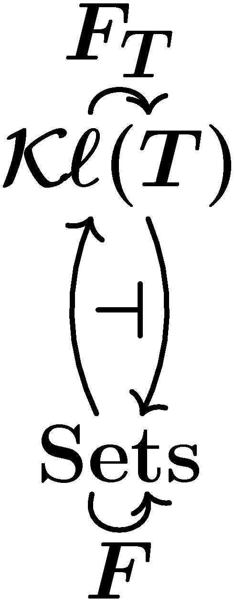
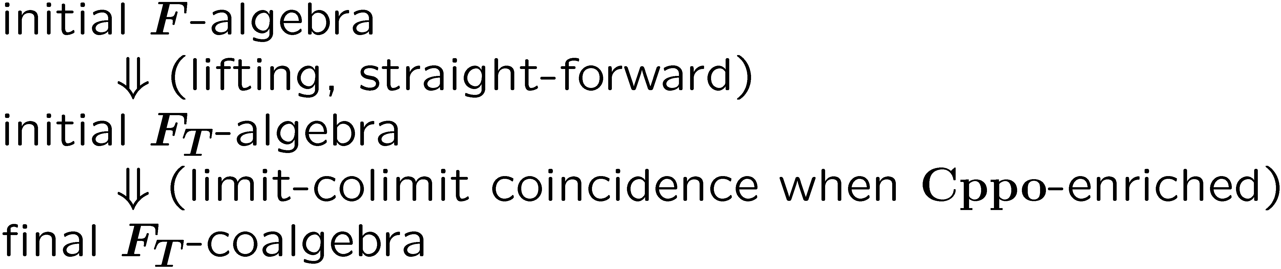
Final coalgebra in a Kleisli category
Theorem
  T : a comm. monad s.t. Kl(T) is Cppo-enriched
  A final coalgebra in Kl(T) is given by an initial algebra in Sets
Proof.
for a polynomial/shapely functor F,
9 distr. law FT => TF,
which lifts F to F_{T} : Kl(T) -> Kl(T)
Generic Trace Semantics via Coinduction
IH, Bart Jacobs & Ana Sokolova
Logical Method in Comp. Sci.
3(4:11), 2007

Slide 28

A closer look at the proof
Initial algebra from the initial sequence…

Slide 29

A closer look at the proof
whole diagram mapped by J: Sets -> Kl(T)
J (a left adjoint) preserves colimits
Each arrow here is an embedding in a domain-theoretic sense…

Slide 30

A closer look at the proof
Take corresponding projections
colimits are turned into limits (Smyth-Plotkin)
  cf. axiomatic domain theory, algebraic completeness/compactness, …

Slide 31
A closer look at the proof
The sequence turns out to be the final sequence
Hence we’ve constructed a final coalgebra

Slide 32
Different “branching-types”
in Kl(T) captures
trace semantics
T : parameter for “branching-type”
trace semantics:
ab
ac
trace semantics:
ab : 1/3
ac : 2/3
T = P
T = D
non-deterministic branching
probabilistic branching
a
a
a
a
b
c
b
1
1
c
Notes:
These are (only) main examples

Slide 33


Coalgebraic simulations
morphism of coalgebras
in Sets
functional bisimulation(standard)
in Kl(T)
??
observation
lax morphism
= forward
simulation
oplax morphism
= backward
simulation
genericity again : both for
T = P (non-determinism)
T = D (probability)
theorem (soundness)
9 fwd/bwd simulation ➔ trace inclusion
Generic Forward and Backward Simulations
IH
Proc. CONCUR 2006
LNCS 4137

Slide 34
Summary so far
genericity : both for
T = P (non-determinism)
T = D (probability)
 | in Sets | in Kl(T)
coalgebra | system | system
morphism of coalgebra | functional bisimilarity | forward simulation (lax) backward similation (oplax)
by final coalgebra | bisimilarity | trace semantics
theory of bisimilarity
theory of traces and simulations

Slide 35
Case study: probabilistic anonymity
Simulation-based proof method for
non-deterministic anonymity [KawabeMST06]
T = P
generic, coalgebraic theory of traces and simulations
Probabilistic Anonymity via Coalgebraic Simulations
IH & Yoshinobu Kawabe
Proc. ESOP 2007
LNCS 4421
T = D
Simulation-based proof method for
probabilistic anonymity

Slide 36


Summary
= ?
Bisimilarity vs. trace semantics
  Bisimilarity via coinduction in Sets
  Trace semantics via coinduction in a Kleisli category
    Non-deterministic branching (T=P)
    Probabilistic branching (T=D)
    Final coalgebra in Kl(T) = initial algebra in Sets
(Monad + order) as essence of “branching”
Thanks for your attention!
  Ichiro Hasuo (RIMS, Kyoto-U)
  http://www.kurims.kyoto-u.ac.jp/~ichiro

Slide 37
Serendipity: fool’s gold?

