Slide 1

Ichiro Hasuo
Tracing Anonymity with Coalgebras
TexPoint fonts used in EMF.
Read the TexPoint manual before you delete this box.: AAAAAA
Notes:
use text effect?

Slide 2
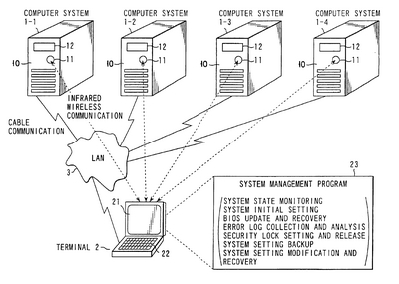
The ultimate aim
Better mathematical understanding of computer systems
Computer systems
pervasive, important
fail easily
…
we don’t quite understand them!

Slide 3
Coalgebras
mathematical simplicity
(potential) applicability
Our mathematical presentation of systems
Good balance:
In this thesis:
more applications are found
further mathematical theory is developed

Slide 4
Coalgebras
 | coalgebraically
system | coalgebra
behavior-preserving map | morphism of coalgebras
behavior | by final coalgebra

Slide 5
Overview
Coalgebraic theory of traces and simulations (Ch. 2-3)
via coalgebras in a Kleisli category
apply to both
case study: probabilistic anonymity (Ch. 4)
Concurrency in coalgebras (Ch. 5)
the microcosm principle appears
non-determinism
probability
Notes:
Speak short

Slide 6
In Sets: bisimilarity
behavior by final coalgebra
system as coalgebra
NB
what they mean exactly depends on which category they’re in
standard
“behavior” captures bisimilarity
they are in the category Sets
category = “universe”
  Sets, Top, Stone, Vect, CLat, …
X, FX, FZ, … | sets
X → Y | function
Notes:
Category = universe

Slide 7

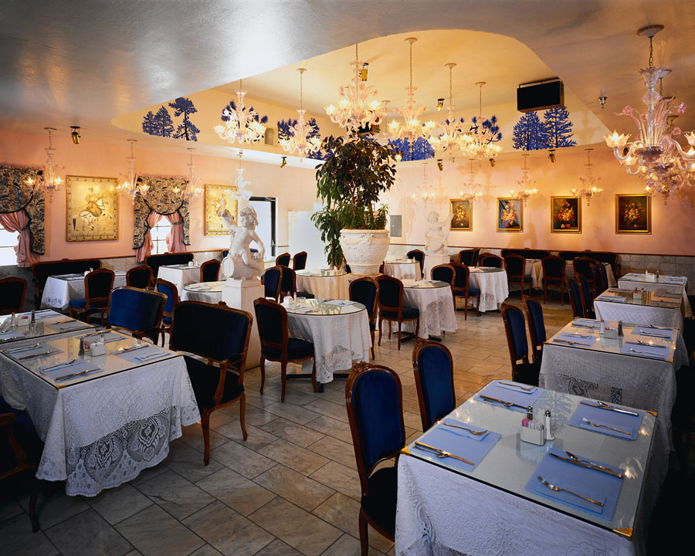


Bisimilarity vs. trace semantics
a
a
≠
a
Also captured by final coalgebra?
b
c
=
b
c
Bisimilarity
When do we decide
or ?
Trace semantics
Anyway we get
→ or
→
Notes:
For some applications, you really need to think of trace semantics!

Slide 8
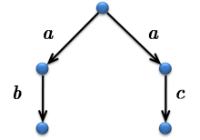
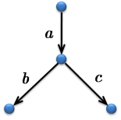
Coalgebraic trace semantics
“Kleisli category”
a category where
branching is implicit
  X → Y : “branching function” from X to Y
T : parameter for branching-type
Behavior by final coalgebra
captures…
in Sets
bisimilarity (standard)
in Kl(T)
trace semantics (Ch. 2)
Generic Trace Semantics via Coinduction
IH, Bart Jacobs & Ana Sokolova
Logical Method in Comp. Sci.
3(4:11), 2007
≠
=

Slide 9
Different “branching-types”
in Kl(T) captures
trace semantics
T : parameter for “branching-type”
trace semantics:
a → b
a → c
trace semantics:
a → b : 1/3
a → c : 2/3
T = P
T = D
non-deterministic branching
probabilistic branching
a
a
a
a
b
c
b
1
1
c
Notes:
These are (only) main examples

Slide 10
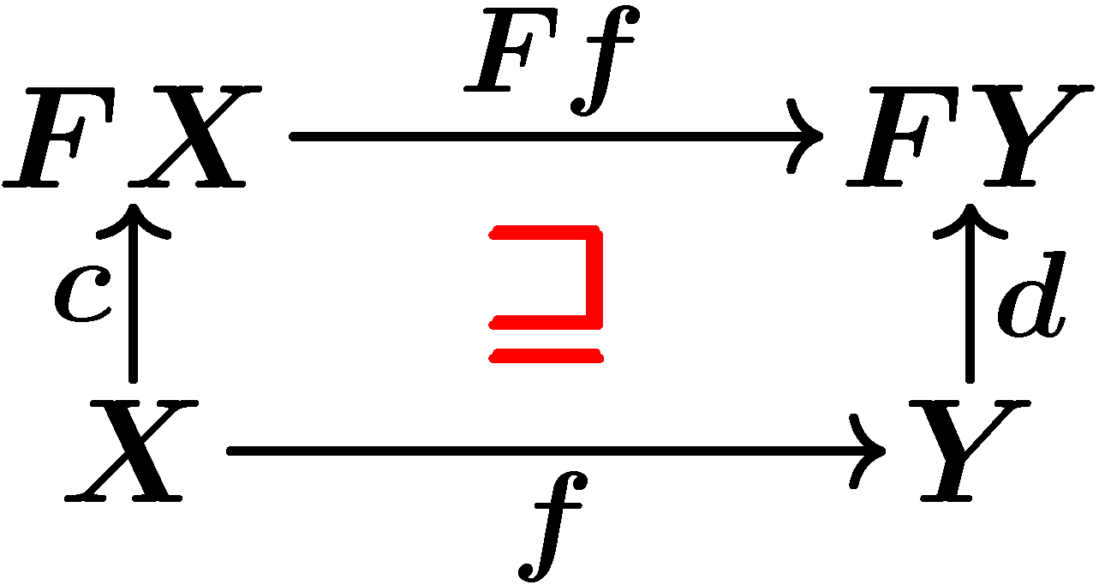
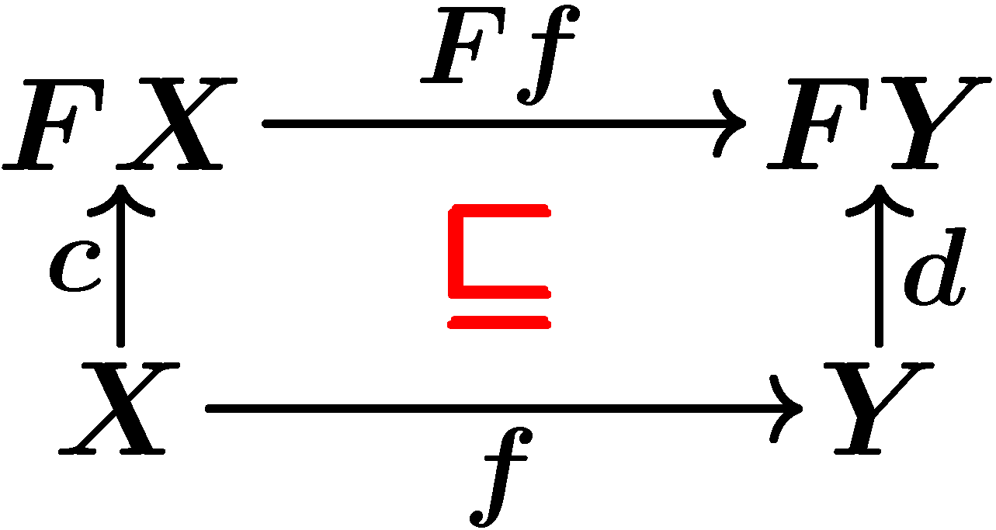
Coalgebraic simulations (Ch. 3)
morphism of coalgebras
in Sets
functional bisimulation(standard)
in Kl(T)
??
observation
lax morphism
= forward
simulation
oplax morphism
= backward
simulation
genericity again : both for
T = P (non-determinism)
T = D (probability)
theorem (soundness)
9 fwd/bwd simulation ➔ trace inclusion
Generic Forward and Backward Simulations
IH
Proc. CONCUR 2006
LNCS 4137

Slide 11
Summary so far
genericity : both for
T = P (non-determinism)
T = D (probability)
 | in Sets | in Kl(T)
coalgebra | system | system
morphism of coalgebra | functional bisimilarity | forward simulation (lax) backward similation (oplax)
by final coalgebra | bisimilarity | trace semantics
Ch. 3
Ch. 2
theory of bisimilarity
theory of traces and simulations

Slide 12
Case study: probabilistic anonymity (Ch. 4)
Simulation-based proof method for
non-deterministic anonymity [KawabeMST06]
T = P
generic, coalgebraic theory of traces and simulations
[Ch. 2-3]
Probabilistic Anonymity via Coalgebraic Simulations
IH & Yoshinobu Kawabe
Proc. ESOP 2007
LNCS 4421
T = D
Simulation-based proof method for
probabilistic anonymity

Slide 13
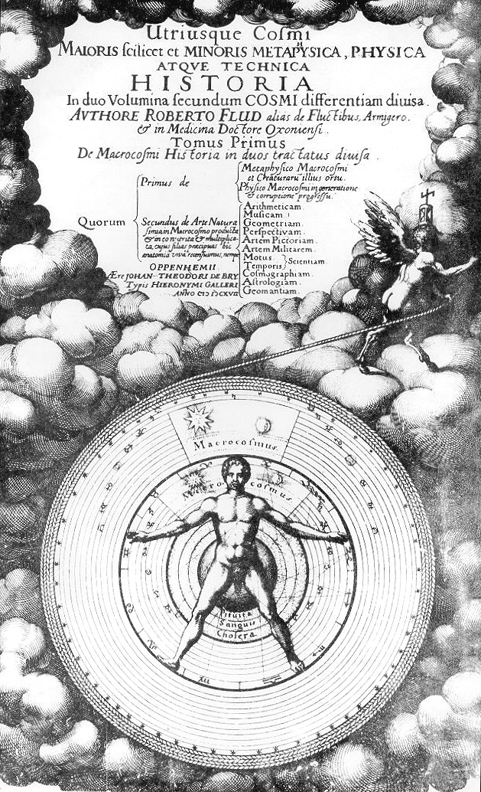
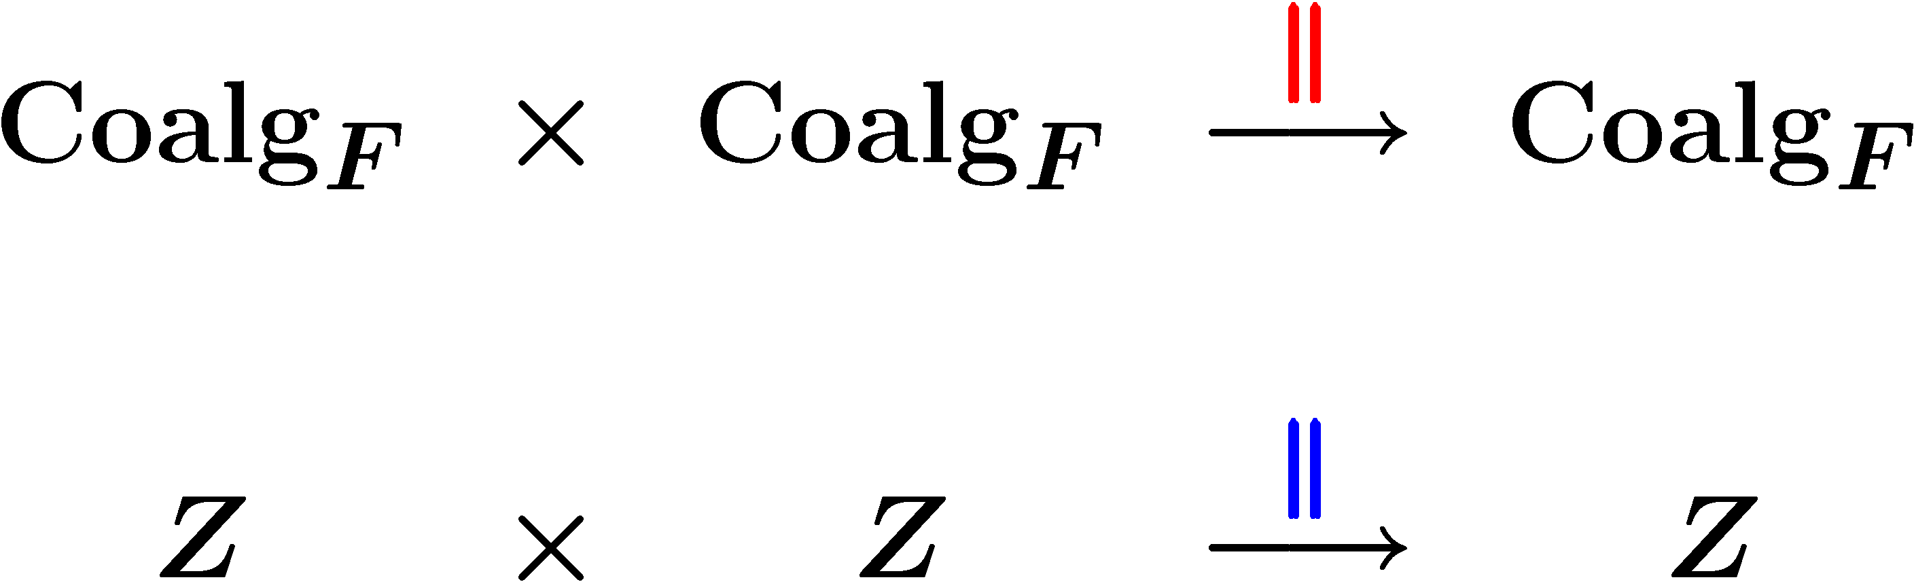
Concurrency
C k D
running C and D in parallel
“concurrency” , “behavior”
2-dimensional , nested algebraic structure
category of coalgebras
inner k
2
final coalgebra
outer k
the microcosm principle

Slide 14
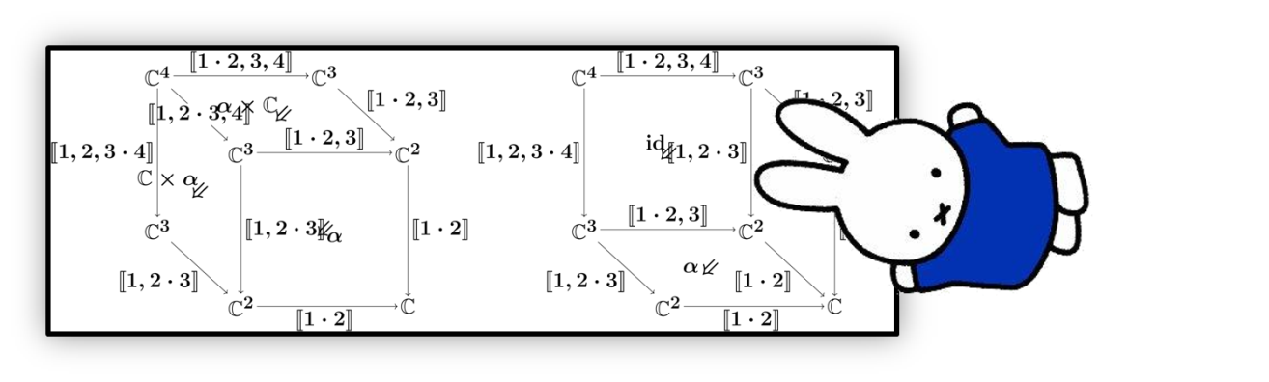
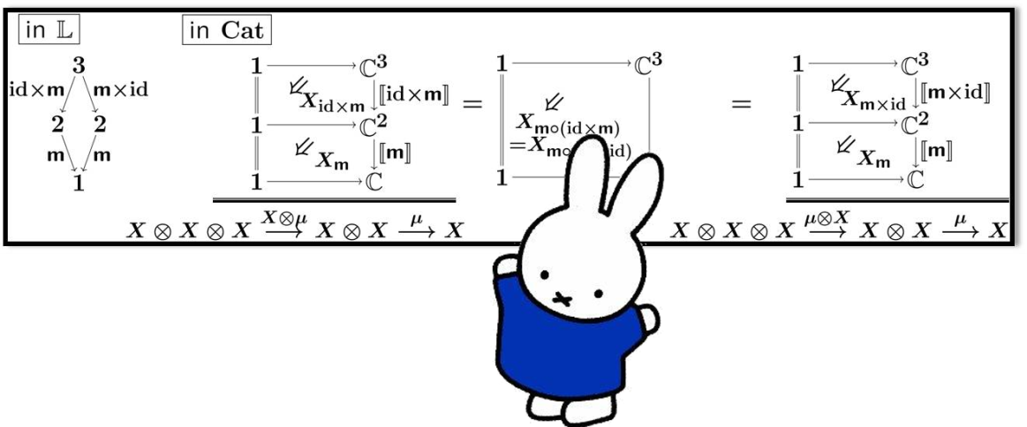
Concurrency and the microcosm principle (Ch. 5)
science of computer systems
concurrency, compositionality, behavior, …
generic compositionality theorem
formalization of microcosm principle in 2-categories
The Microcosm Principle and Concurrency in Coalgebra
IH, Bart Jacobs & Ana Sokolova
To appear in Proc. FoSSaCS 2008
LNCS
mathematics

Slide 15
Summary
Coalgebraic theory of traces and simulations (Ch. 2-3)
via coalgebras in a Kleisli category
apply to both
case study: probabilistic anonymity (Ch. 4)
Concurrency in coalgebras (Ch. 5)
the microcosm principle appears
non-determinism
probability
Notes:
Speak short

